Slide 1
Parallax: Parameterized Local Linear Attention for Language Modeling
DLCT
Jul 31, 2026
Yifei Zuo¹, Dhruv Pai², Zhichen Zeng³, Alec Dewulf², Shuming Hu², Zhaoran Wang¹
¹Northwestern University, ²Tilde Research, ³University of Washington

Slide 2
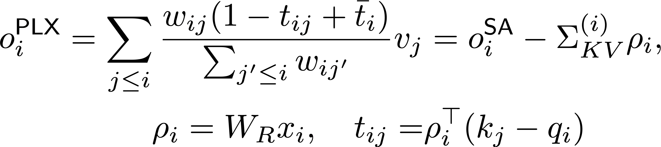
TL;DR
We developed Local Linear Attention (LLA), an improvement over Softmax Attention from a test-time regression perspective.
Parameterized Local Linear Attention (Parallax) is a practical variant of LLA for language modeling.

Slide 3
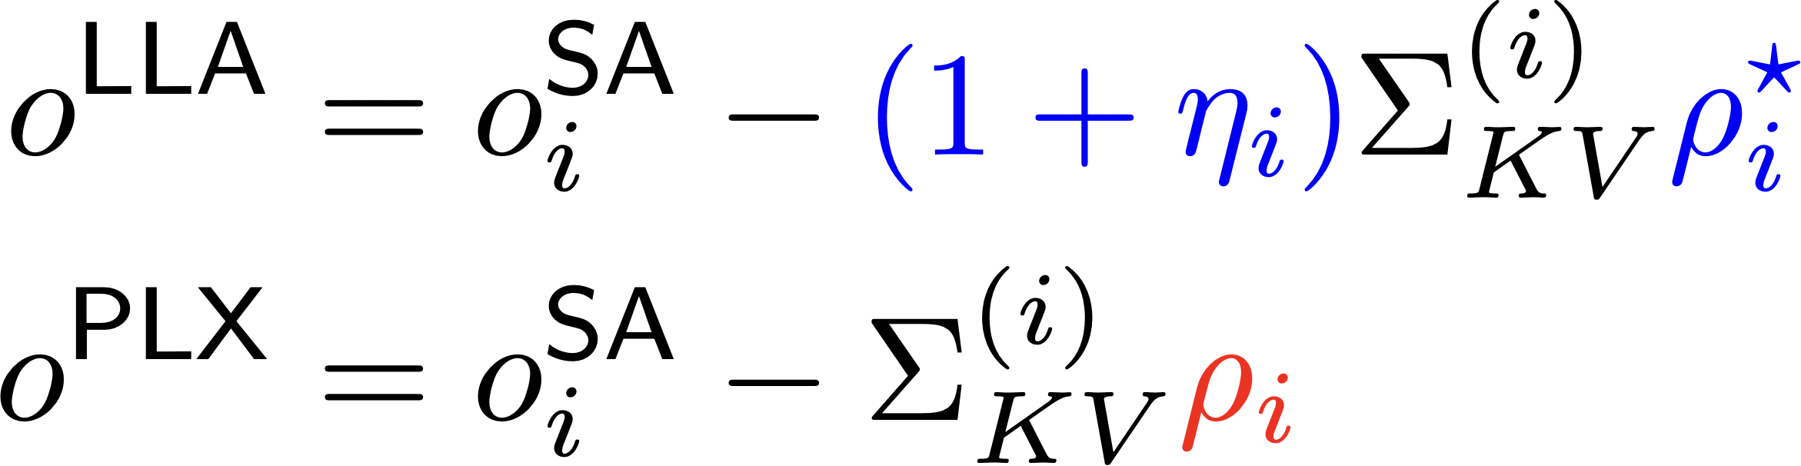
TL;DR
We developed Local Linear Attention (LLA), an improvement over Softmax Attention from a test-time regression perspective.
Parameterized Local Linear Attention (Parallax) is a practical variant of LLA for language modeling.

Slide 4
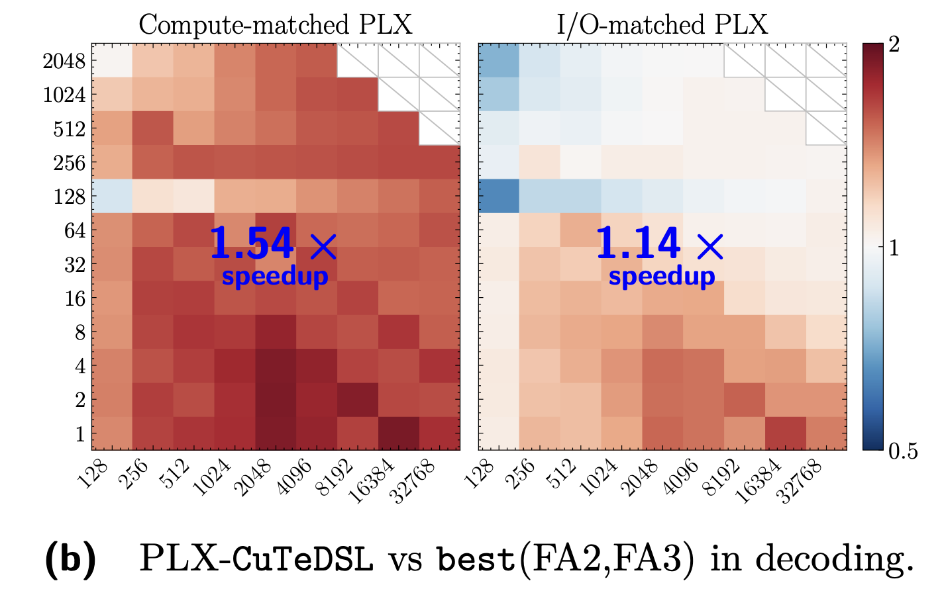
Efficiency
Parallax increases arithmetic intensity and is hardware-efficient.

Slide 5
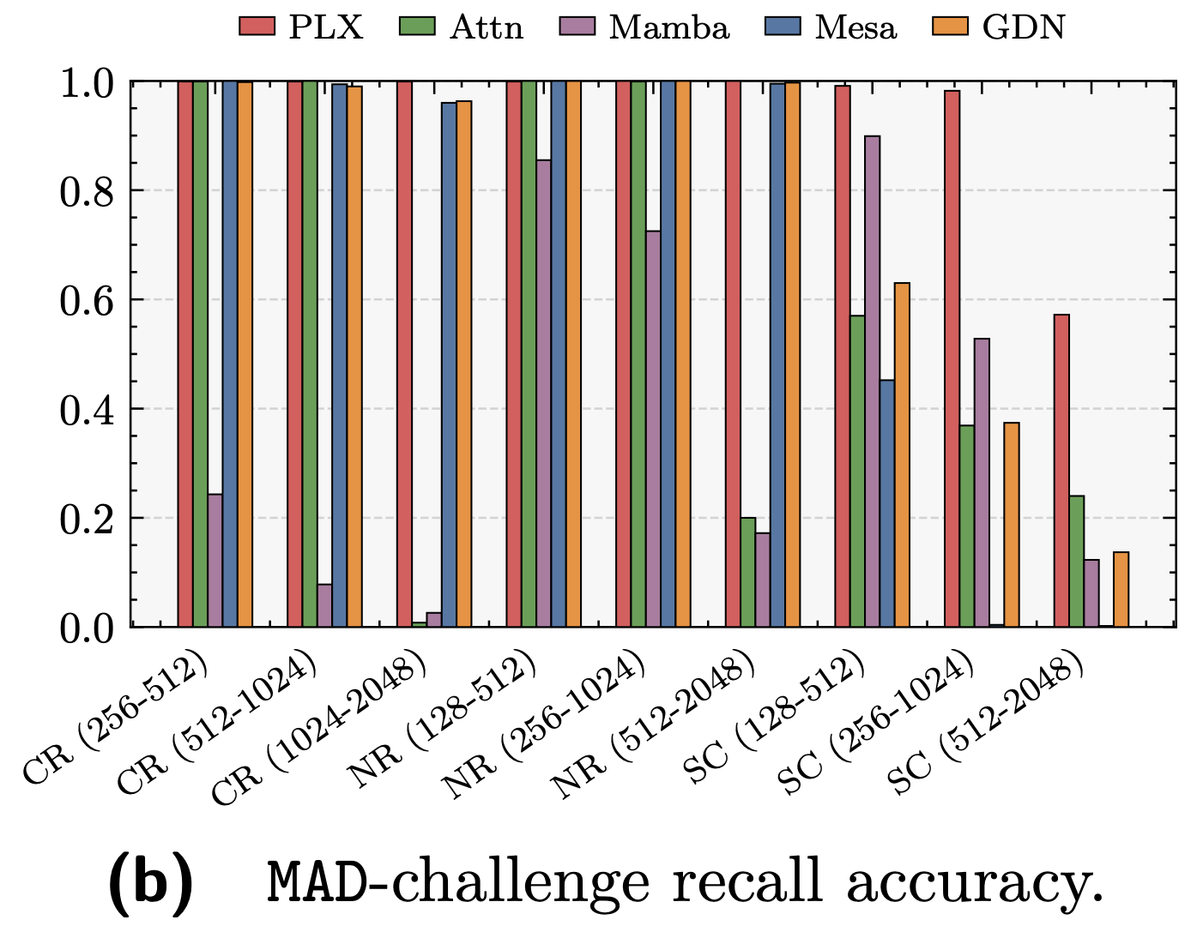
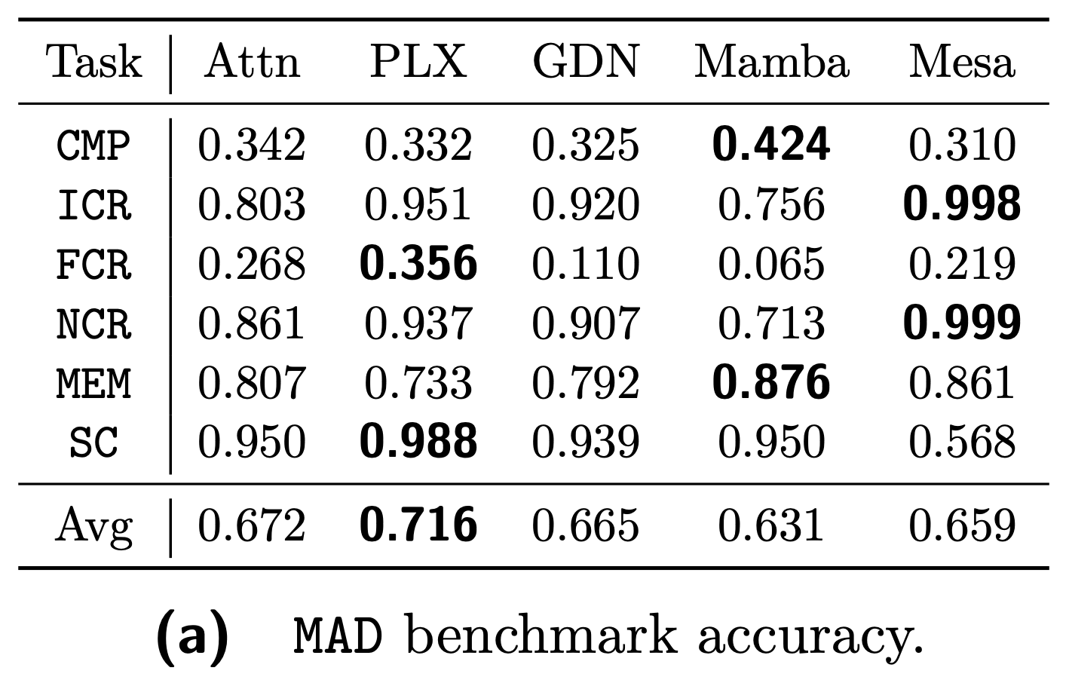
Performance
Parallax performs better on the MAD synthetic benchmarks.

Slide 6
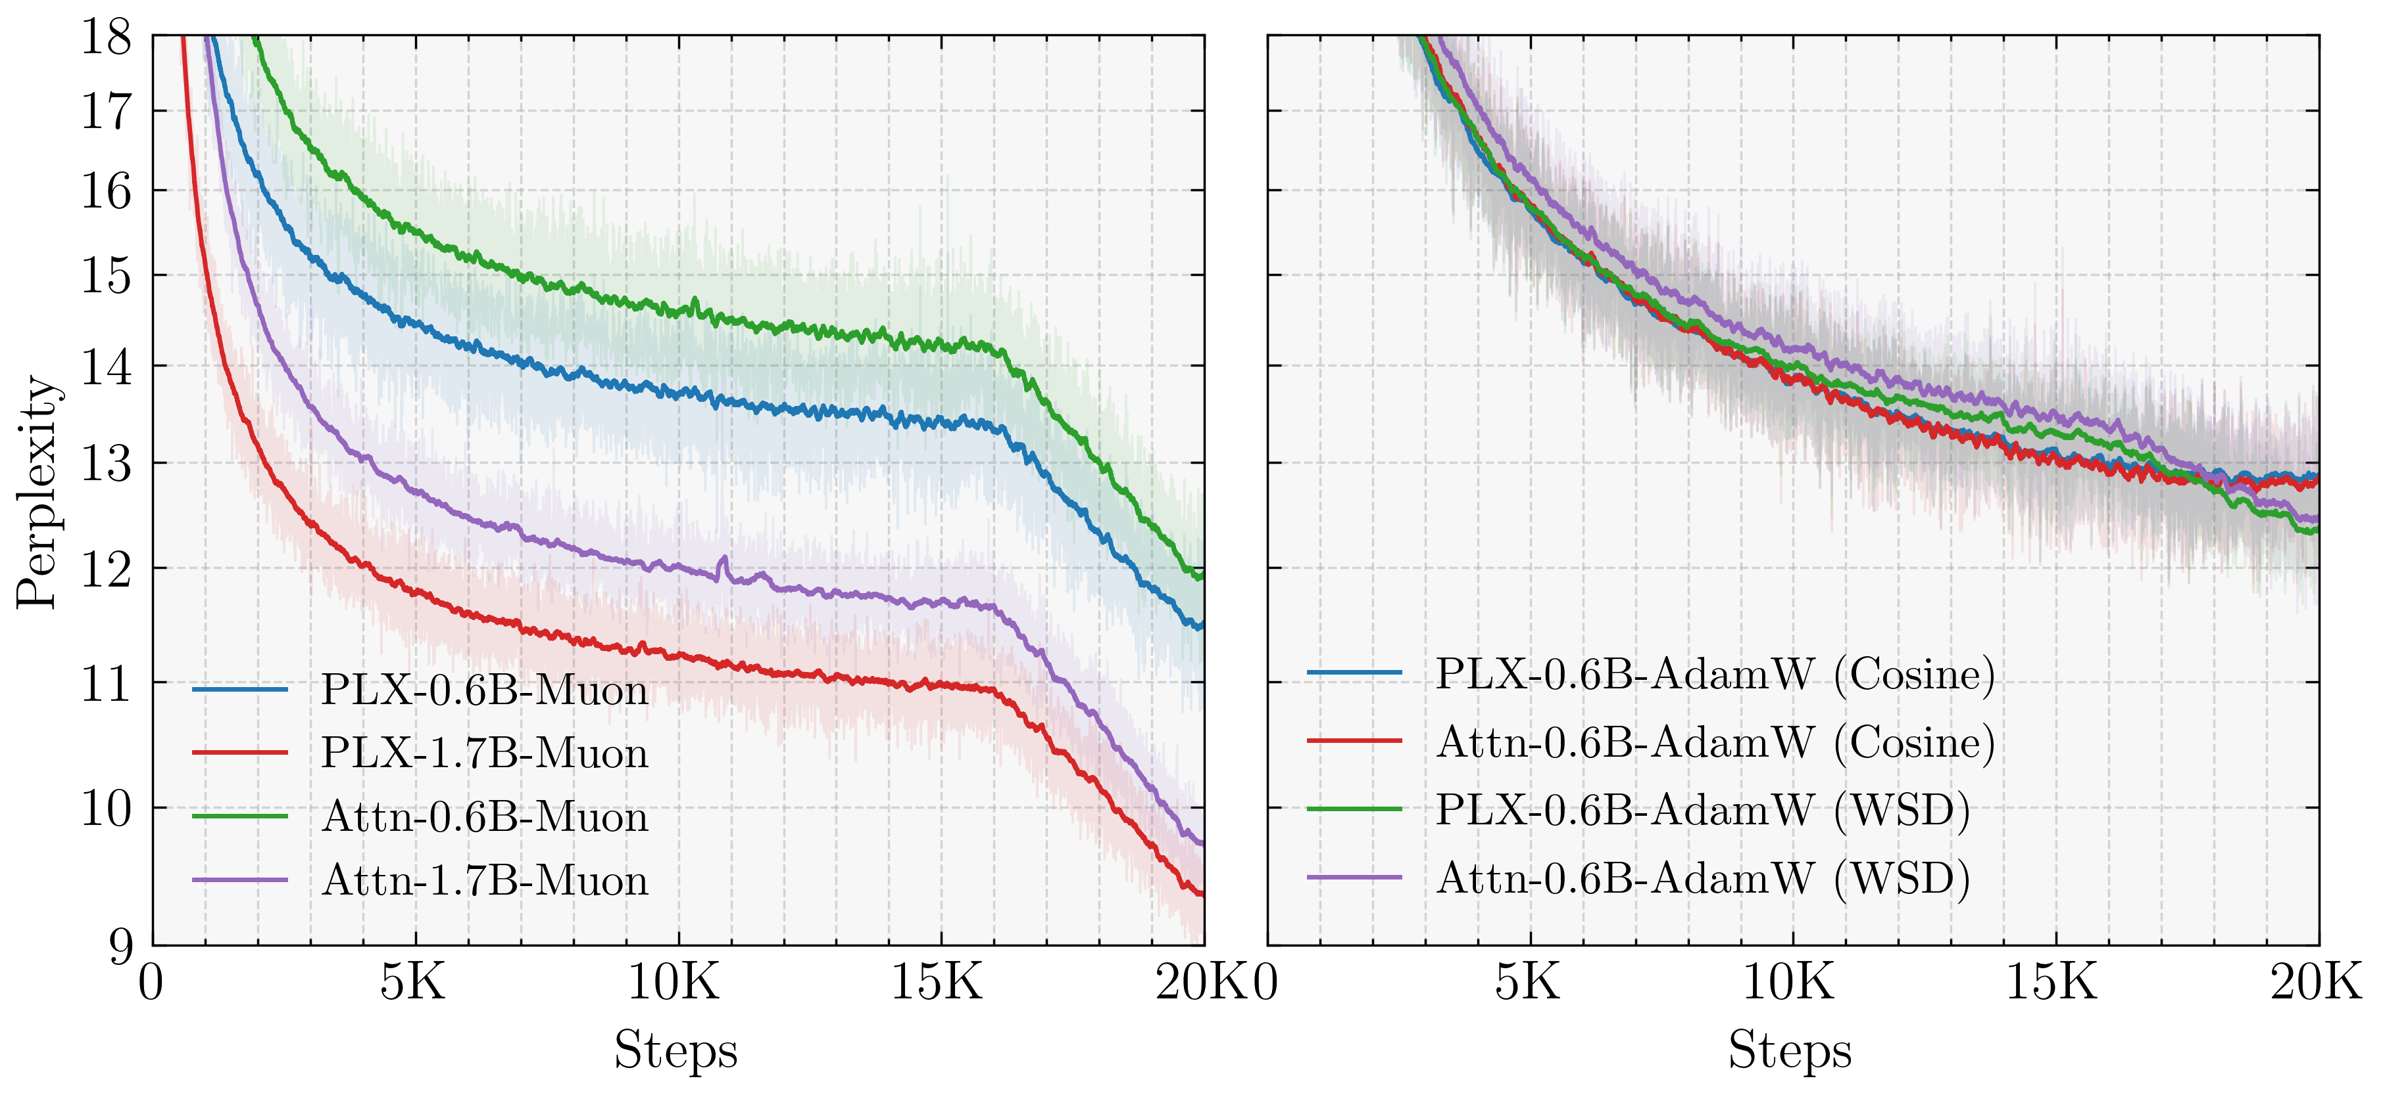
Performance
Parallax outperforms SA during pretraining at the 0.6B and 1.7B scales, but its performance is optimizer-dependent.
80B tokens for 0.6B scale
160B tokens for 1.7B scale

Slide 7
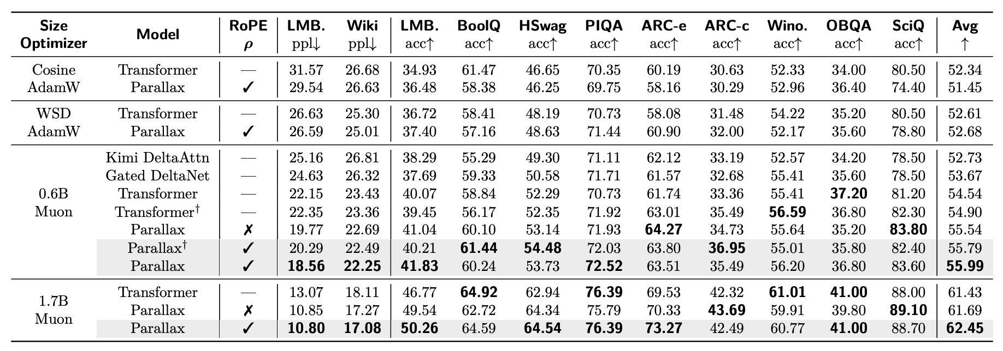
Performance
With Muon, Parallax retains its advantage in both parameter-matched and compute-matched comparisons.

Slide 8
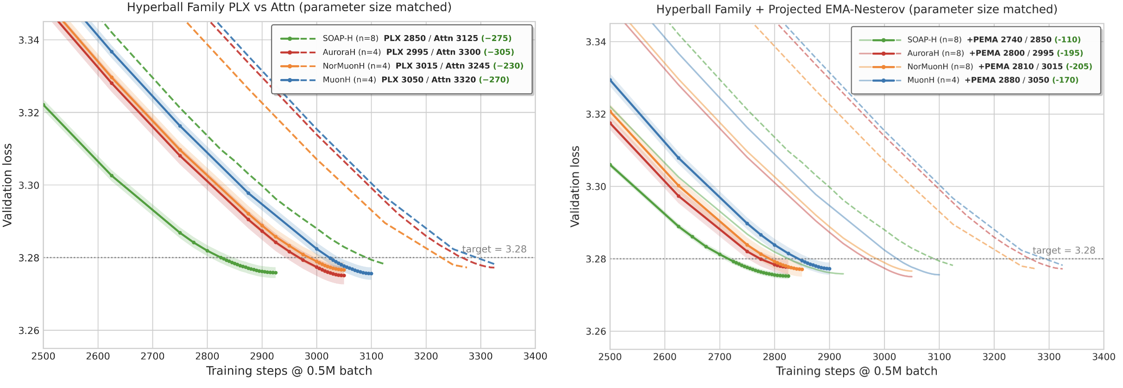
Performance
Parallax also benefits from advanced optimizers, including Aurora, NorMuon, SOAP and their Hyperball/EMA variants.

Slide 9
Performance
Parallax also benefits from advanced optimizers, including Aurora, NorMuon, SOAP and their Hyperball/EMA variants.
Acknowledgments:
Haoxiang Wang (TML)
Min Li (UIUC)

Slide 10
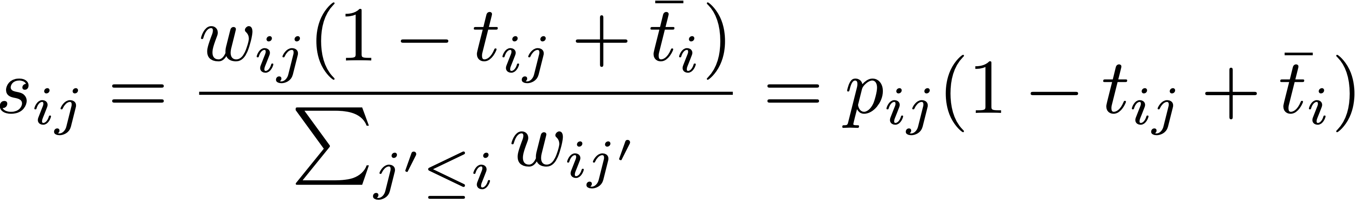
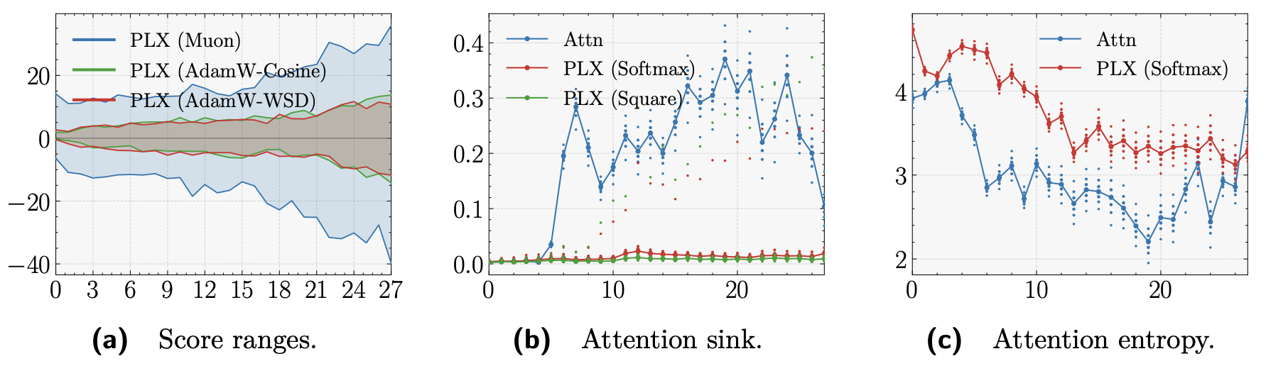
Parallax Score Patterns
Parallax scores are signed and span a wide numerical range.

Slide 11
Parallax Score Patterns
Parallax suppresses the attention sinks.

Slide 12
Parallax Score Patterns
Parallax yields higher attention entropy.

Slide 13
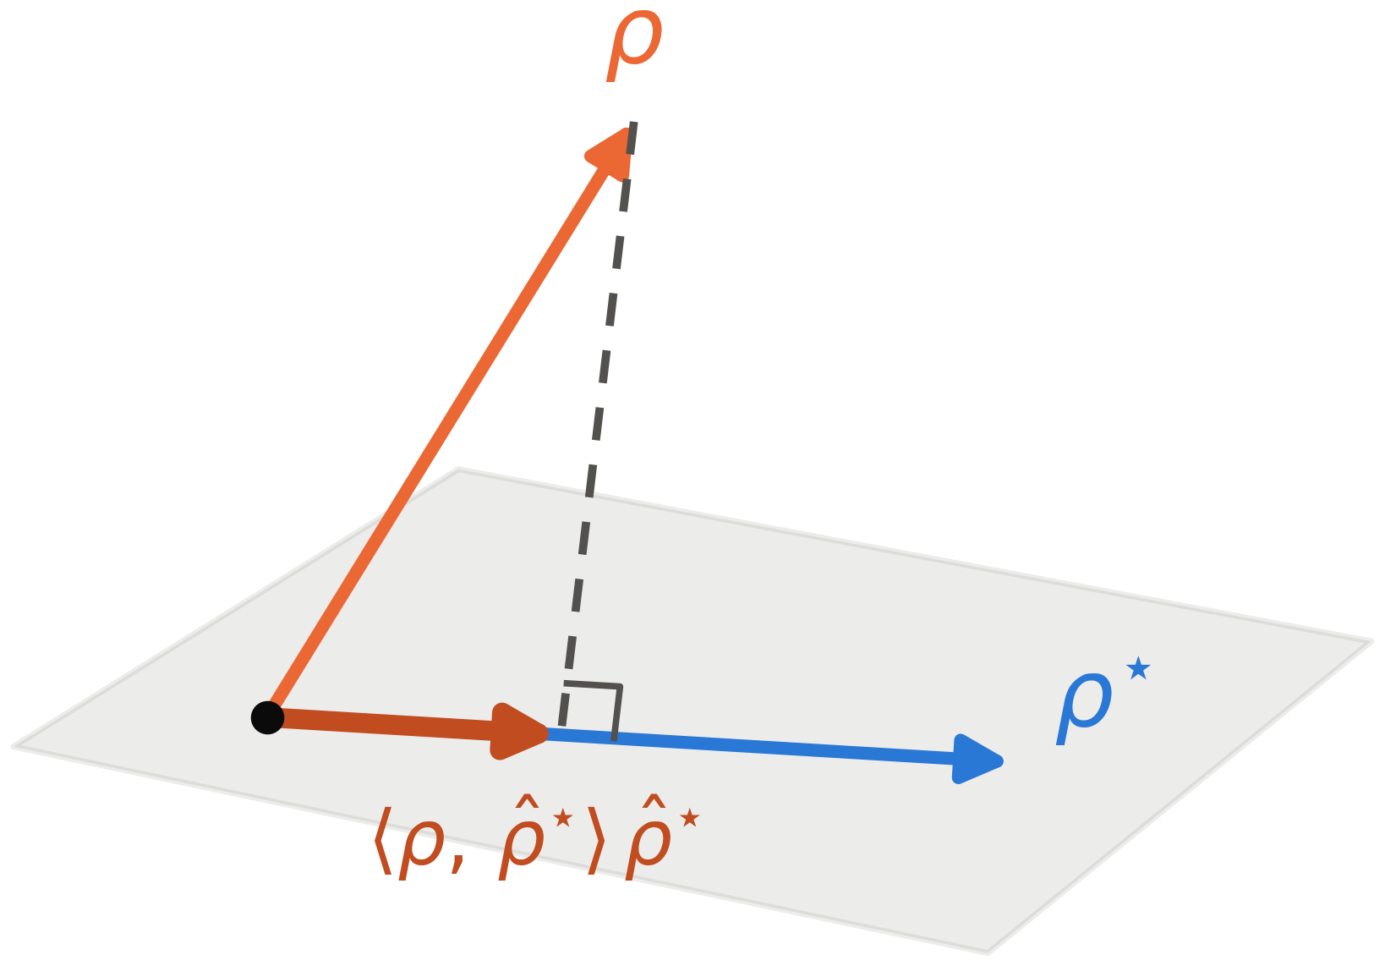
Mechanism Analysis
The affine structure induces magnitude requirements.

Slide 14
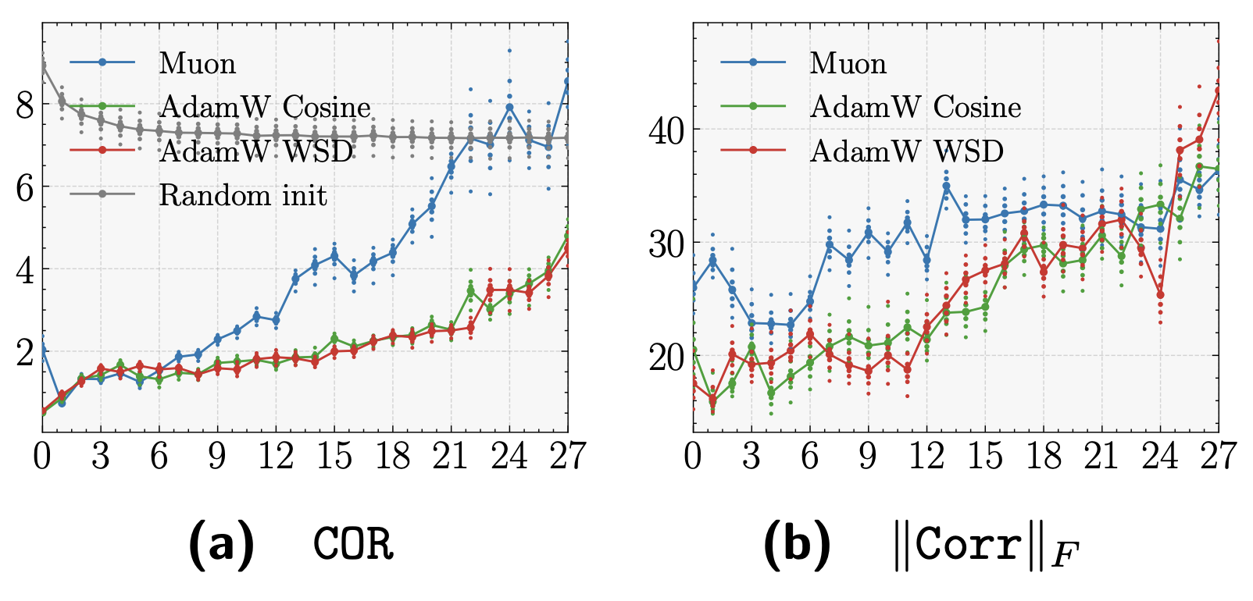

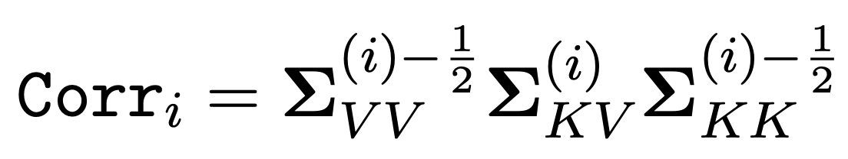
Mechanism Analysis
The covariance correction branch is used more effectively when trained with Muon.

Slide 15
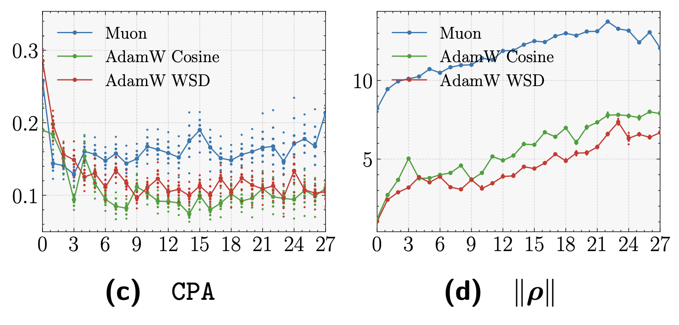
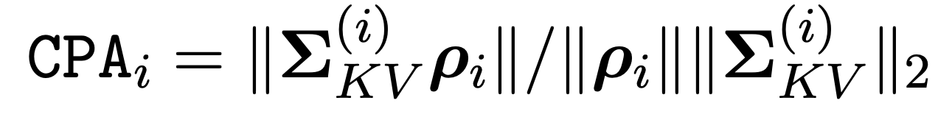
Mechanism Analysis
The covariance correction branch is used more effectively when trained with Muon.

Slide 16
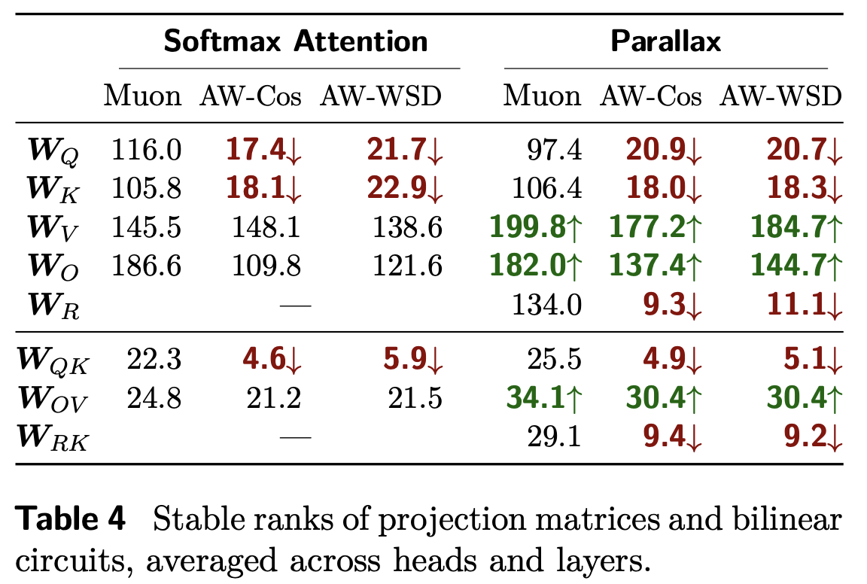
Mechanism Analysis
Muon prevents stable rank collapse in the QK and RK circuits.
Parallax improves the OV circuit across all optimizers.

Slide 17
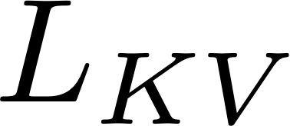
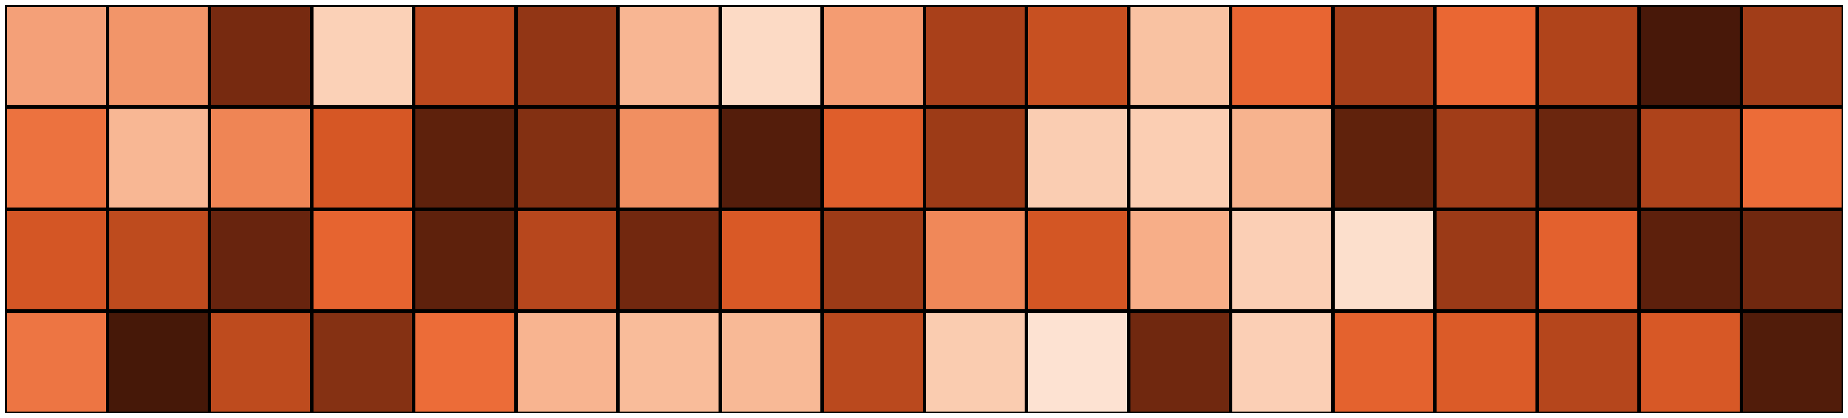
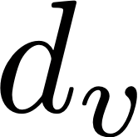
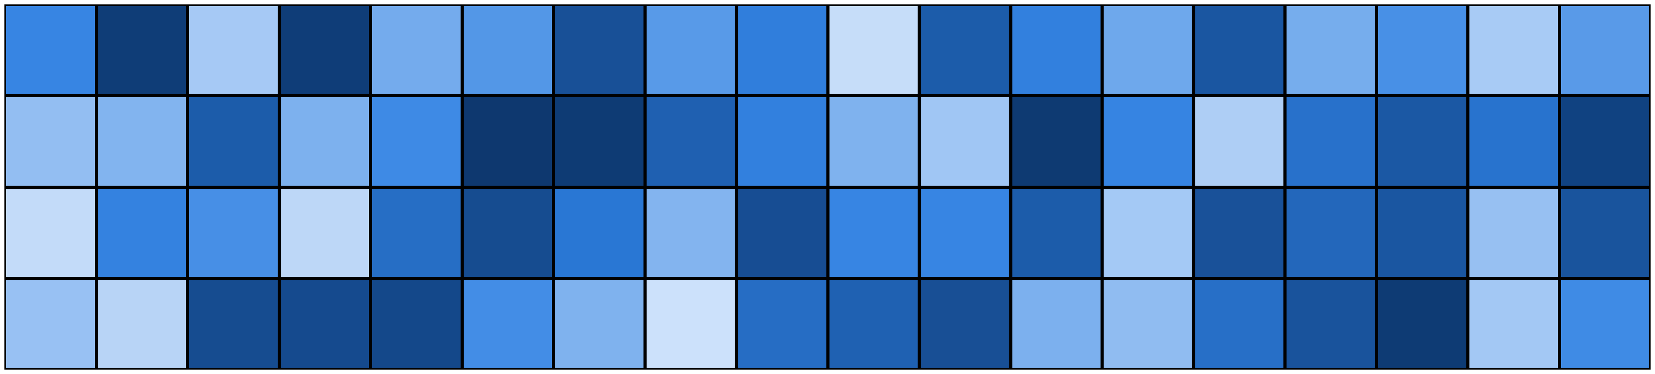
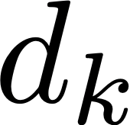
From Associative Memory to Attention
V
K

Slide 18

From Associative Memory to Attention
V
K
q

Slide 19
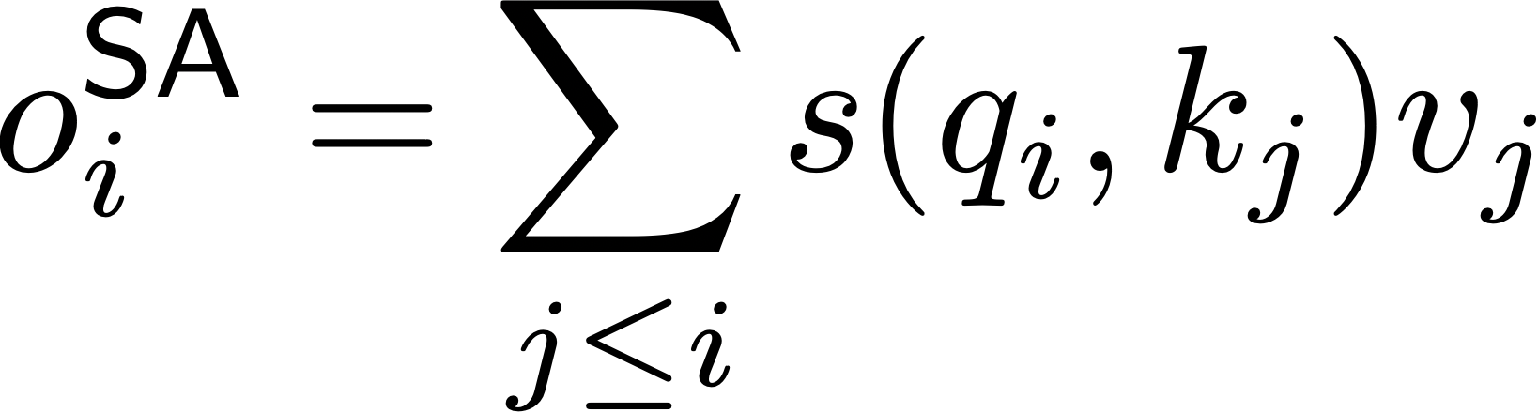
From Associative Memory to Attention
V
K
q

Slide 20
From Associative Memory to Attention
V
K
q

Slide 21
From Associative Memory to Attention
V
K
q

Slide 22
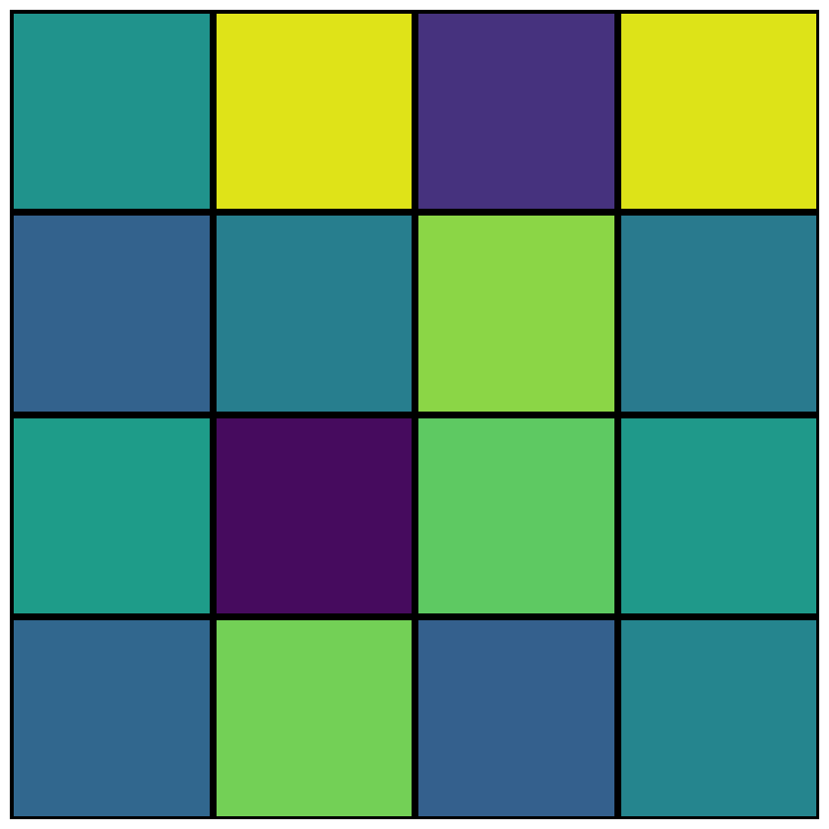
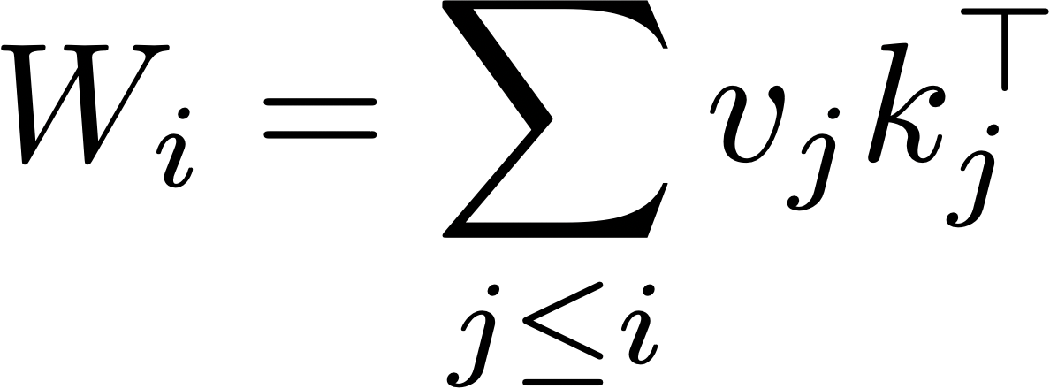
From Associative Memory to Attention
V
K
q

Slide 23
From Associative Memory to Attention
V
q
K
q

Slide 24
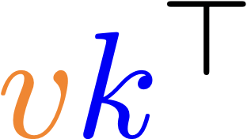



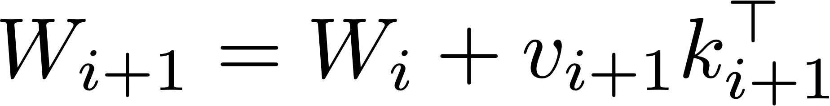
From Associative Memory to Attention
V
q
K
q

Slide 25
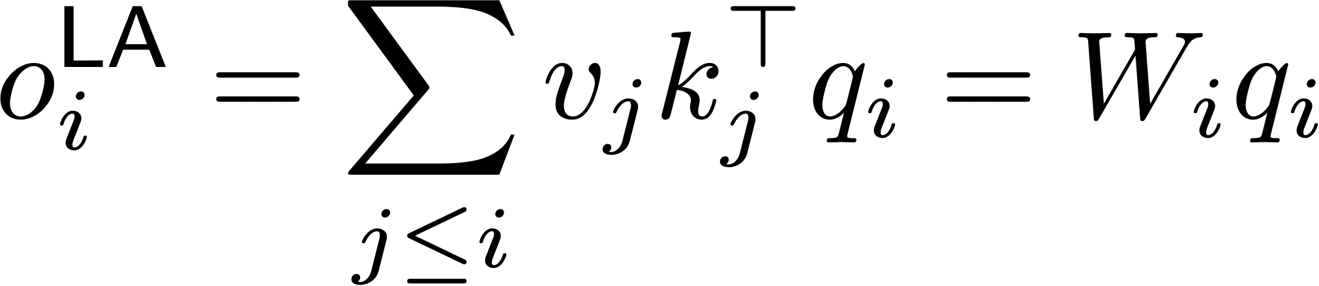
From Associative Memory to Attention
V
q
K
q

Slide 26
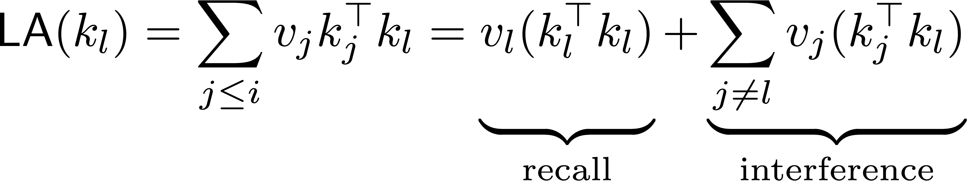
From Associative Memory to Attention

Slide 27
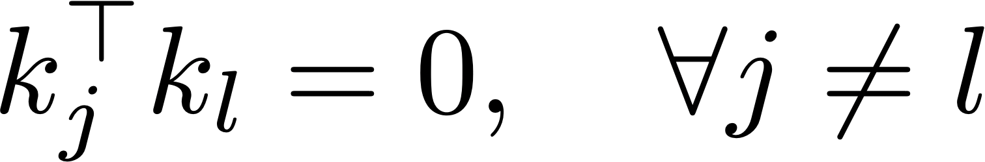
From Associative Memory to Attention
Interference vanishes only for orthogonal keys.
In practice, keys are correlated.
If keys outnumber dims, interference is unavoidable.

Slide 28
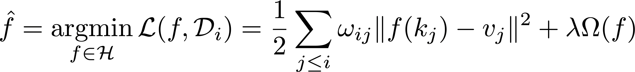
From Associative Memory to Attention
Test Time Regression (Wang et al, 2025)

Slide 29
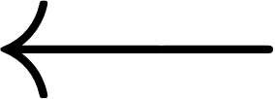
From Associative Memory to Attention
Test Time Regression (Wang et al, 2025)
Hypothesis Space

Slide 30
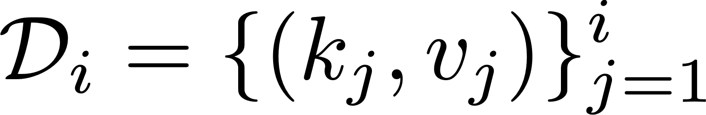
From Associative Memory to Attention
Test Time Regression (Wang et al, 2025)

Slide 31
From Associative Memory to Attention
Test Time Regression (Wang et al, 2025)
(Weighted) MSE

Slide 32
From Associative Memory to Attention
Test Time Regression (Wang et al, 2025)
Regularization

Slide 33
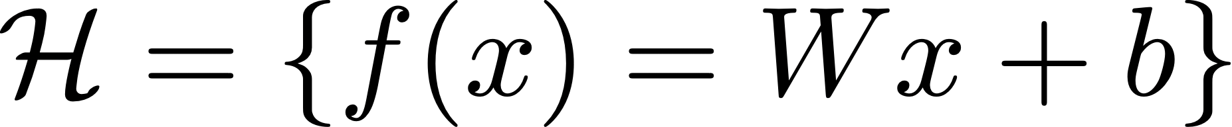
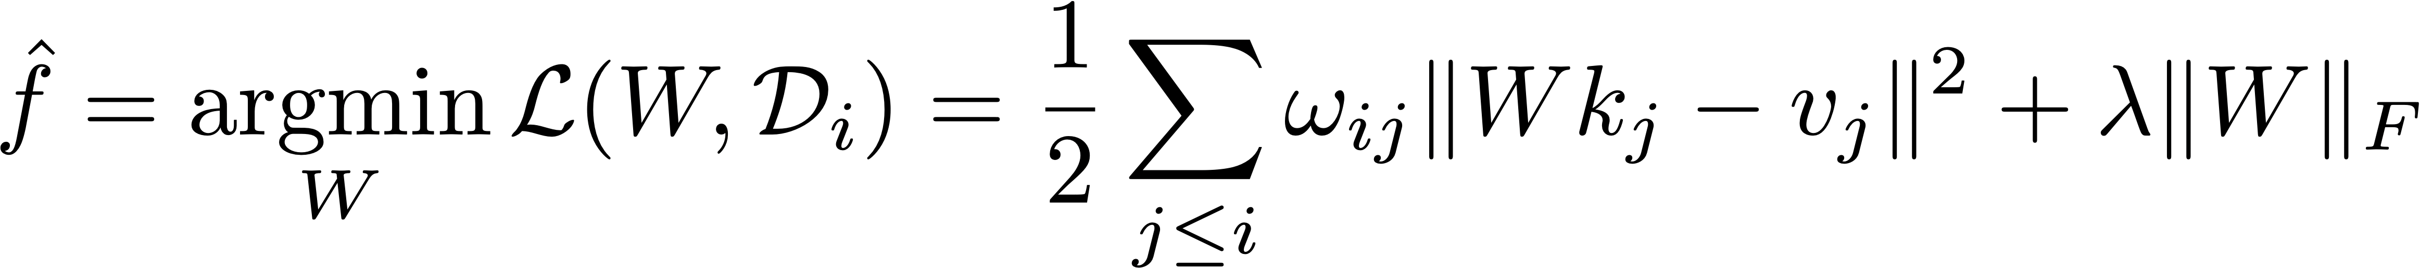
From Associative Memory to Attention
LA corresponds to parametric linear regression
DeltaNet (yang et al., 2024): SGD, unregularized
MesaNet (von Oswald et al., 2026): optimal ridge regression.

Slide 34
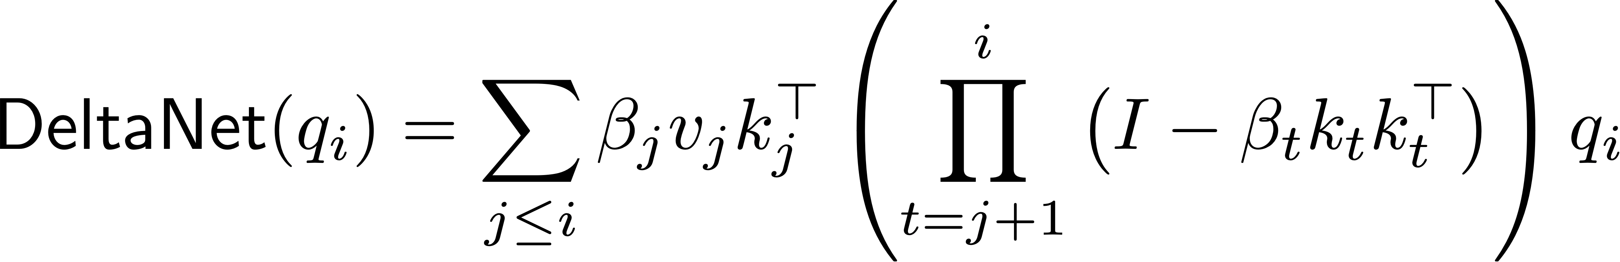
From Associative Memory to Attention
LA corresponds to parametric linear regression
DeltaNet (yang et al., 2024): SGD, unregularized
MesaNet (von Oswald et al., 2026): optimal ridge regression.

Slide 35
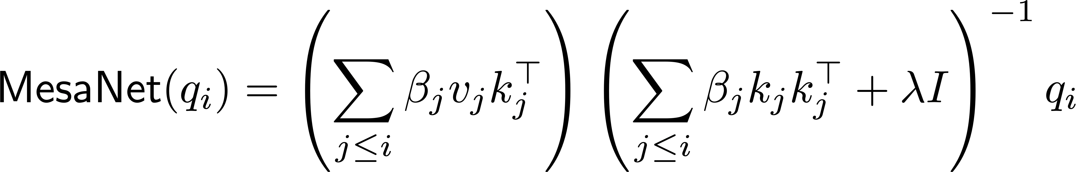
From Associative Memory to Attention
LA corresponds to parametric linear regression
DeltaNet (yang et al., 2024): SGD, unregularized
MesaNet (von Oswald et al., 2026): optimal ridge regression.

Slide 36
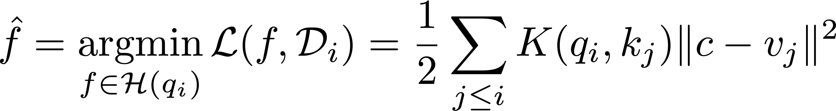
From Associative Memory to Attention
SA corresponds to nonparametric kernel regression
SA is a Local Constant (NW) estimator.
If QKNorm is applied, the kernel becomes an RBF kernel.

Slide 37
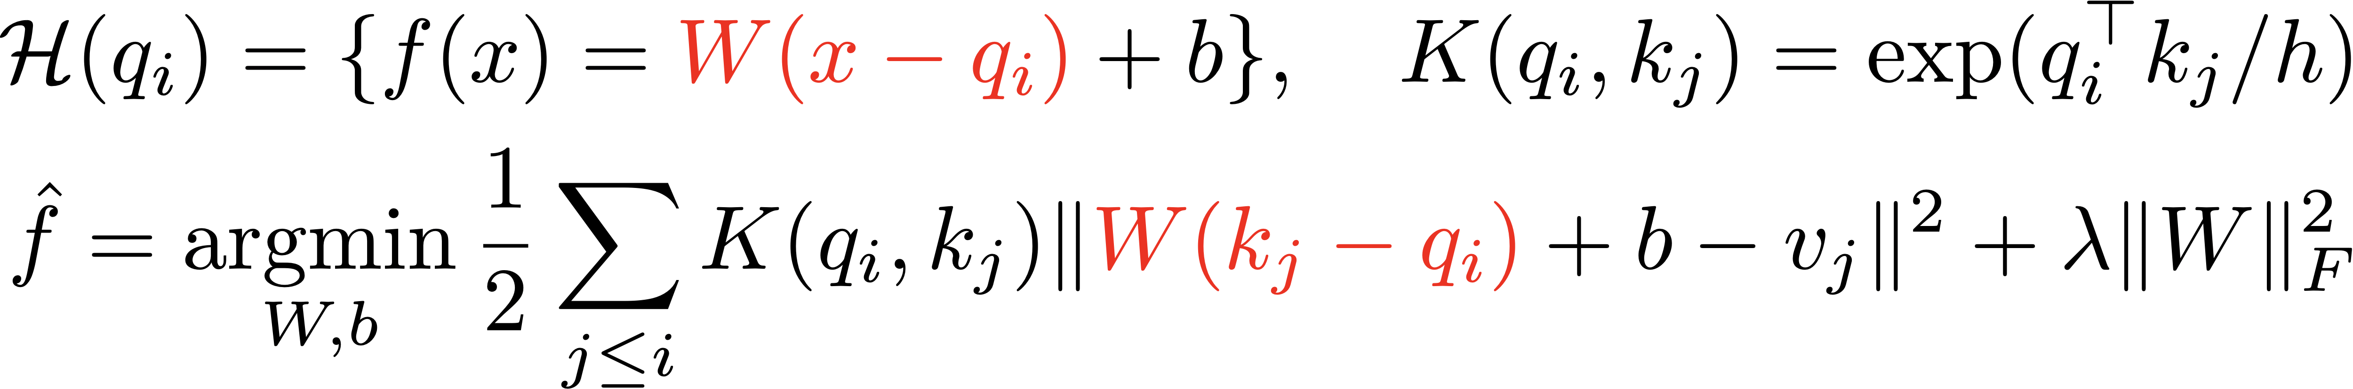
From Associative Memory to Attention
LLA corresponds to nonparametric kernel regression
LLA is a Local Linear estimator.
If QKNorm is applied, the kernel becomes an RBF kernel.

Slide 38
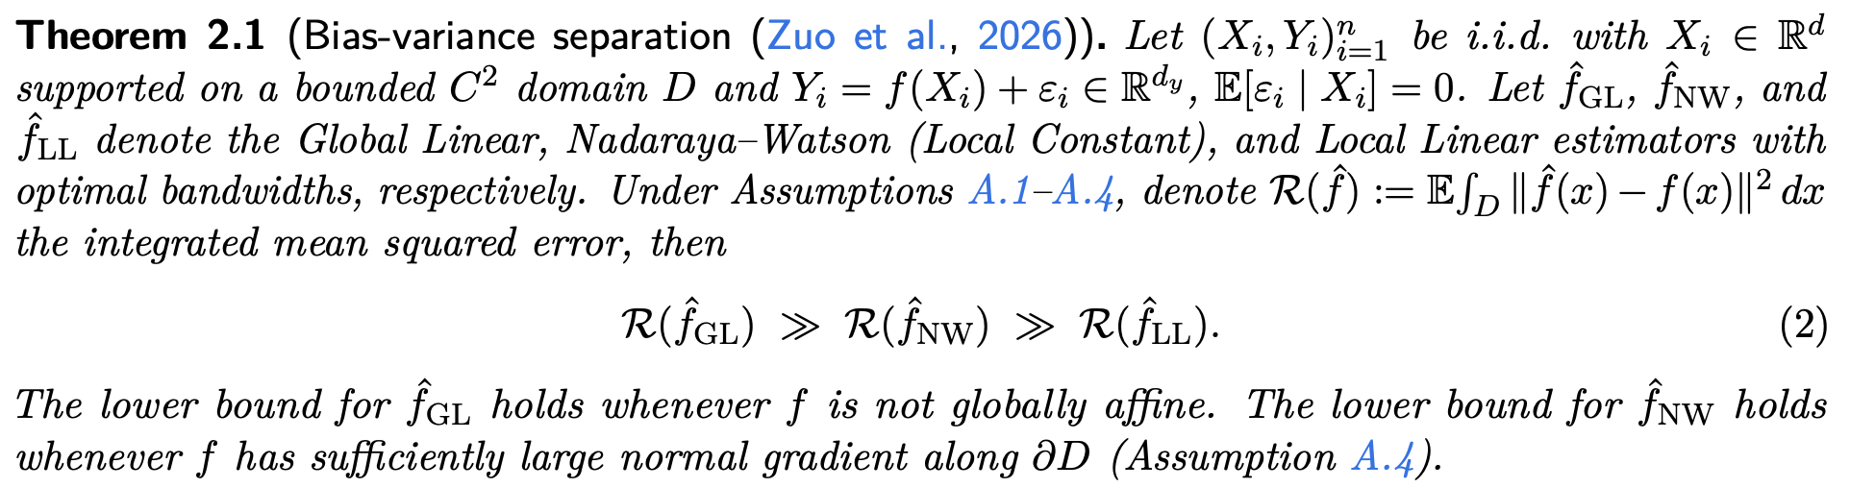
From Associative Memory to Attention
LA (GL): irreducible misspecification error.
SA (NW): unavoidable boundary bias.
LLA (LL): minimax-optimal for C² target.

Slide 39
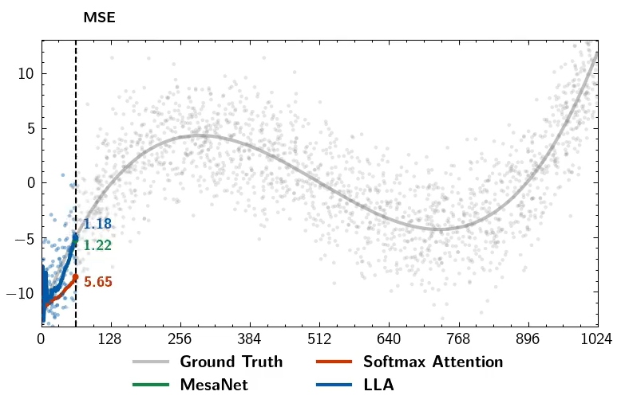
From Associative Memory to Attention

Slide 40
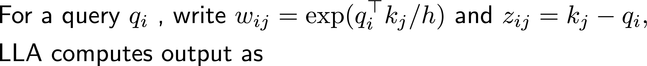
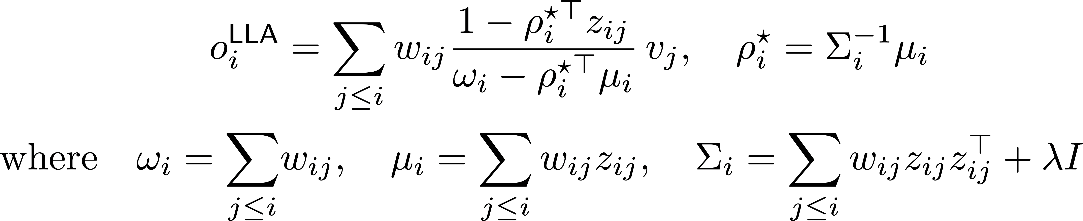
Local Linear Attention

Slide 41
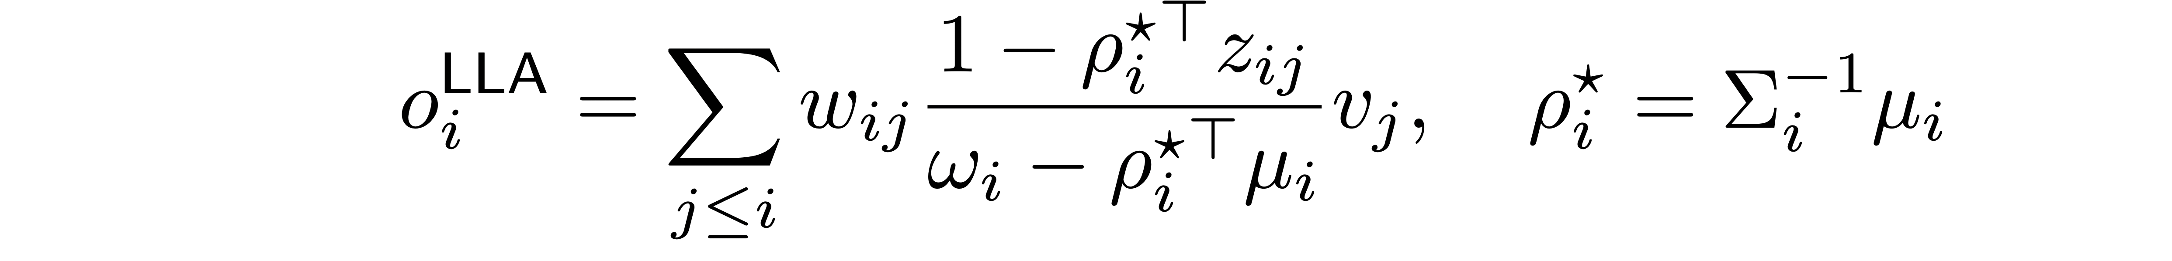
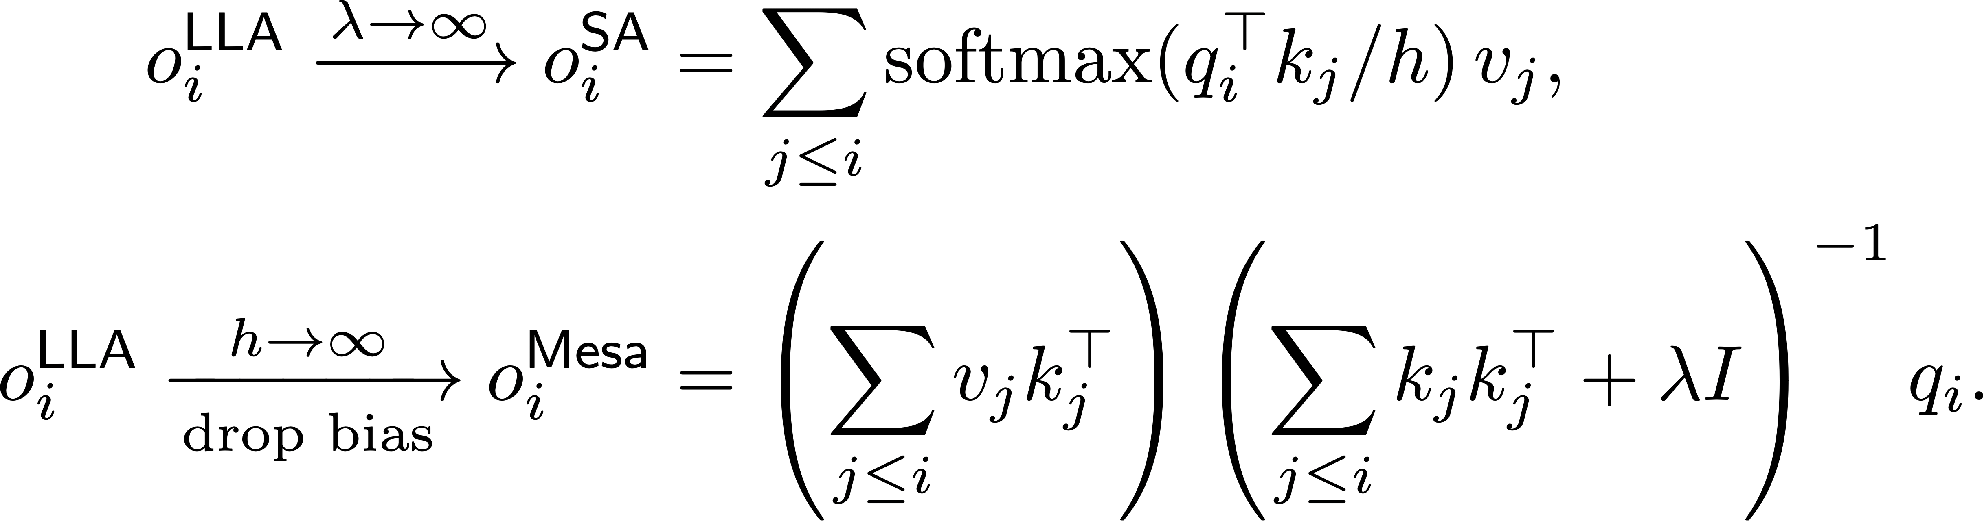
Local Linear Attention

Slide 42
Local Linear Attention
To solve the linear system, LLA introduces a parallel conjugate gradient solver.
High compute and I/O overhead
A regularization–expressiveness trade-off
Incompatibility with low-precision arithmetic

Slide 43
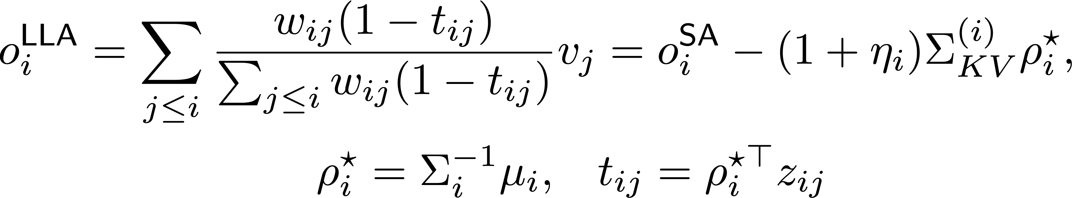
Local Linear Attention

Slide 44
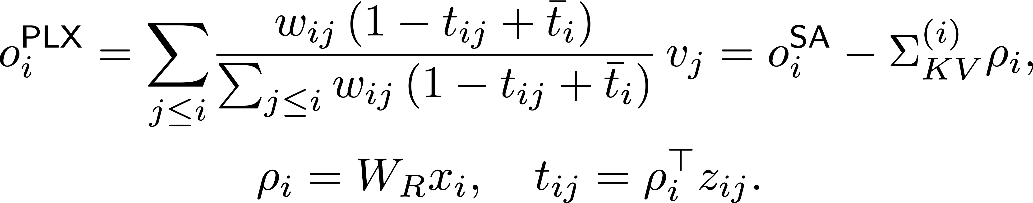
Parameterized Local Linear Attention

Slide 45
Parameterized Local Linear Attention

Slide 46
Parameterized Local Linear Attention

Slide 47
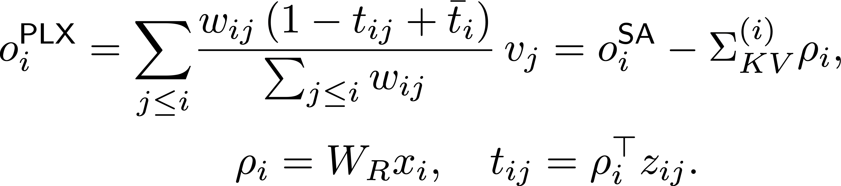
Parameterized Local Linear Attention

Slide 48
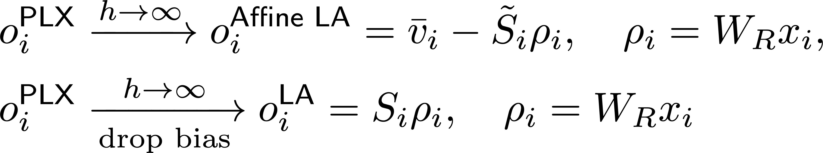
Parameterized Local Linear Attention
In LA, the query corresponds to the probe in Parallax.

Slide 49
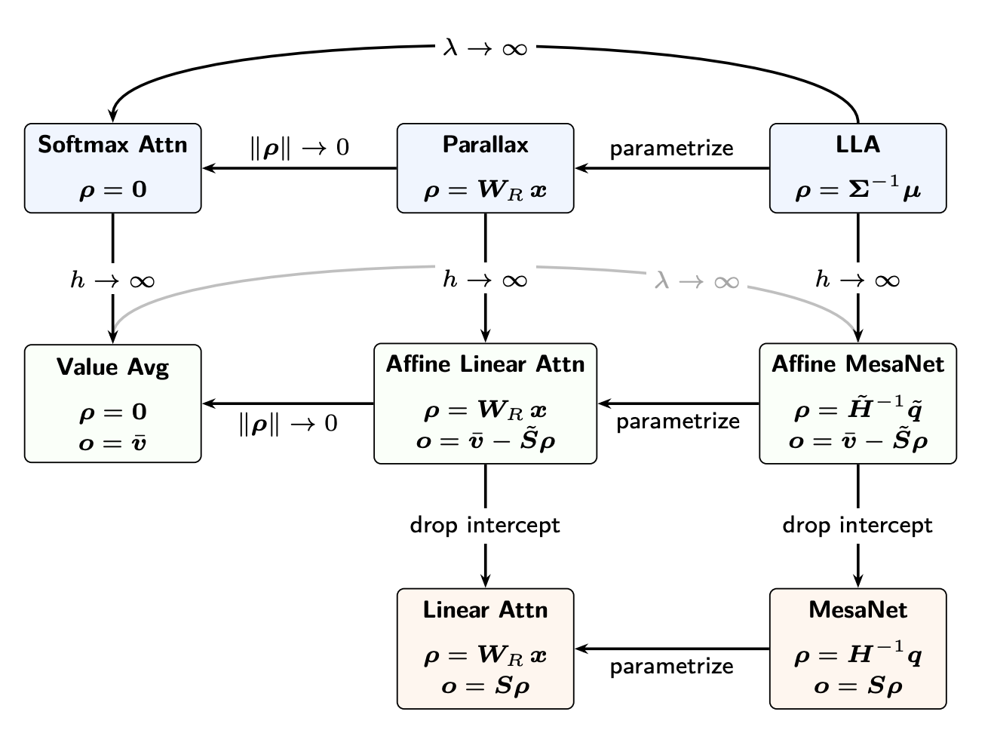
Parameterized Local Linear Attention

Slide 50
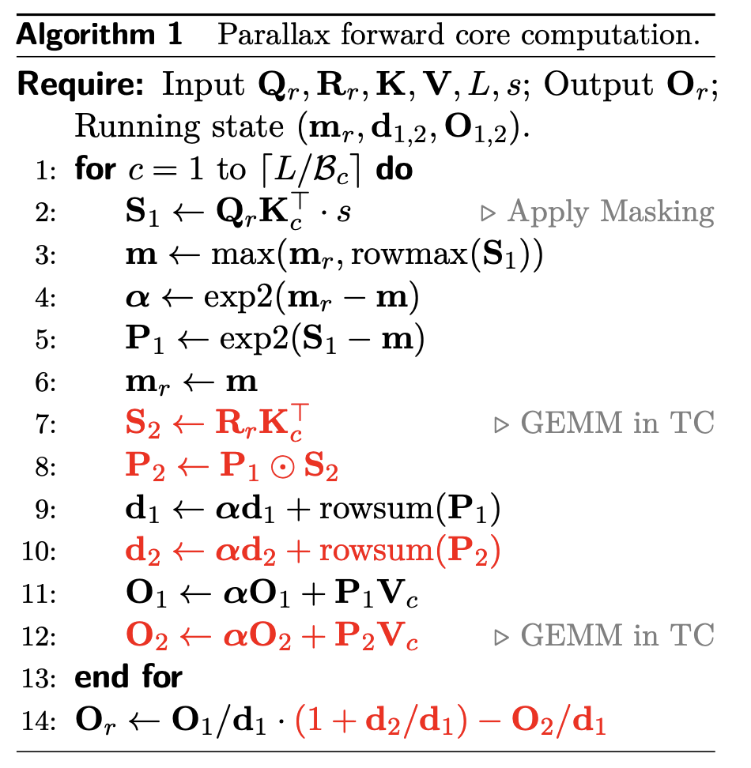

Algorithm
Parallax increases per-head attention FLOPs without increasing I/O.

Slide 51
Future Directions
Gather more empirical evidence on arch–optimizer interactions, develop a theoretical understanding of AdamW degeneracy, and investigate whether architectural remedies exist.
Post-train a Parallax model initialized from a standard attention checkpoint.
Derive a nonparametric counterpart to DeltaNet, extending the connection between Parallax and Linear Attention.
Scale Parallax to larger models and datasets.…

Slide 52
Thanks!

Slide 53

Boundary Amplification Factor
If it is close to 0, the query is close to the weighted key center and the correction becomes pure covariance
If its value is large, the query is close to the weighted key boundary and the correction is amplified to compensate for the boundary bias.

Slide 54

Visualization

Slide 55

Visualization

