Slide 1
Mixture of Thoughts Learning to Aggregate What Experts Think, Not Just What They Say
Jacob Fein-Ashley, Dhruv Parikh, Rajgopal Kannan, Viktor Prasanna

Slide 2
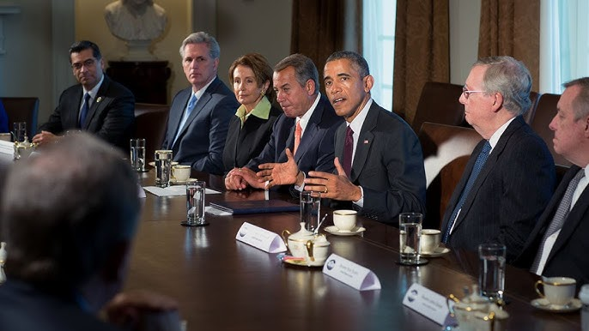
What is an expert system?

Slide 3
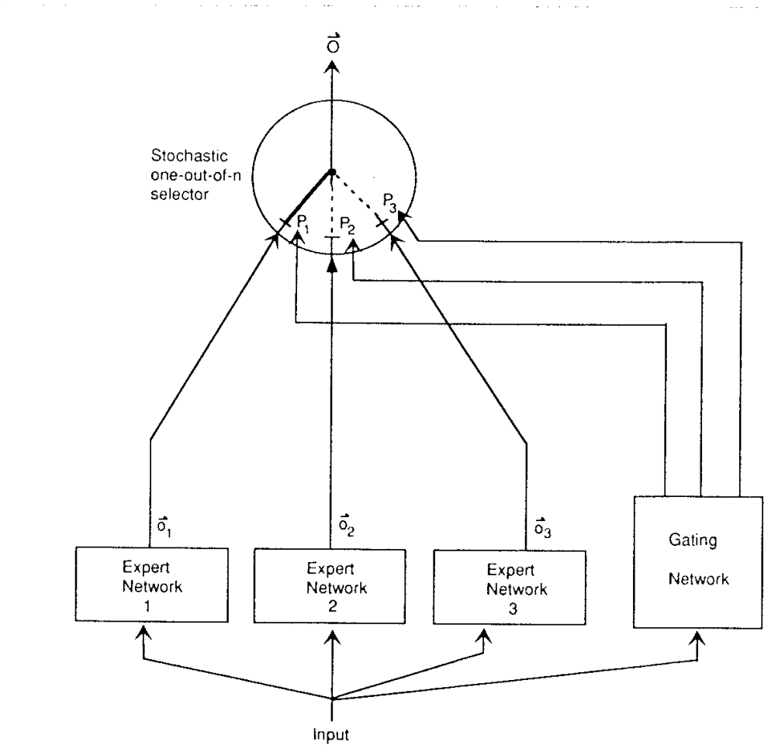
Origin of the Mixture of Experts (MoE)
A gating or “routing” network decides which expert is best for the given input
“Adaptive Mixtures of Local Experts” by Jacobs, Jordan, Nowlan, & Hinton (1991)

Slide 4
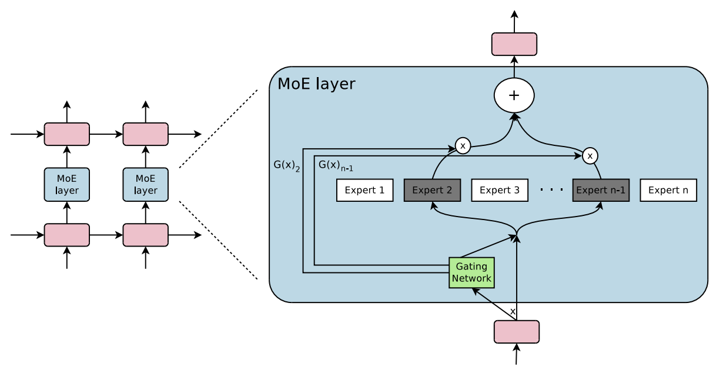
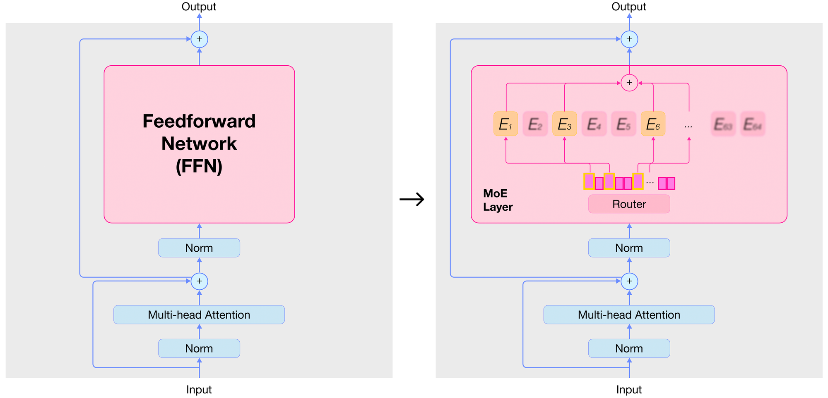
The “Modern” MoE
MoE is popular now because of a trick
Trick: use the gating network to compute a score for each expert for a given token. Only pick the top-K experts for that token
Outrageously Large Neural Networks: The Sparsely-Gated Mixture-of-Experts Layer. Shazeer et al. 2017
Only those selected experts run a forward pass and get gradients
Can get insanely large networks with little cost

Slide 5
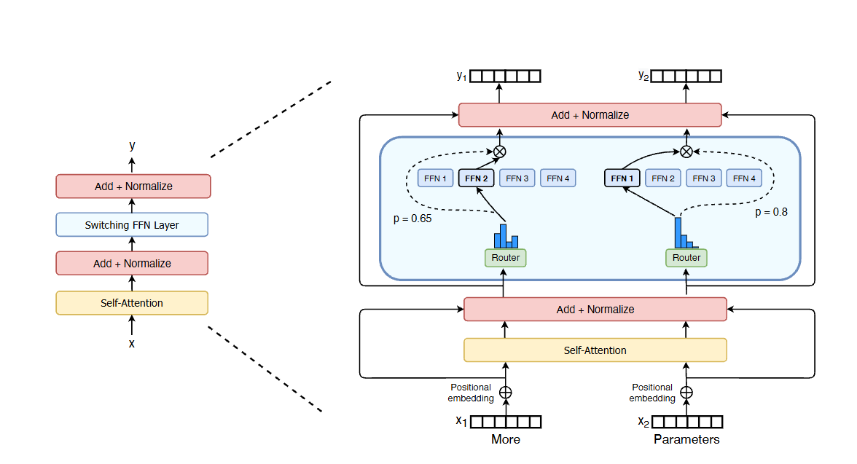
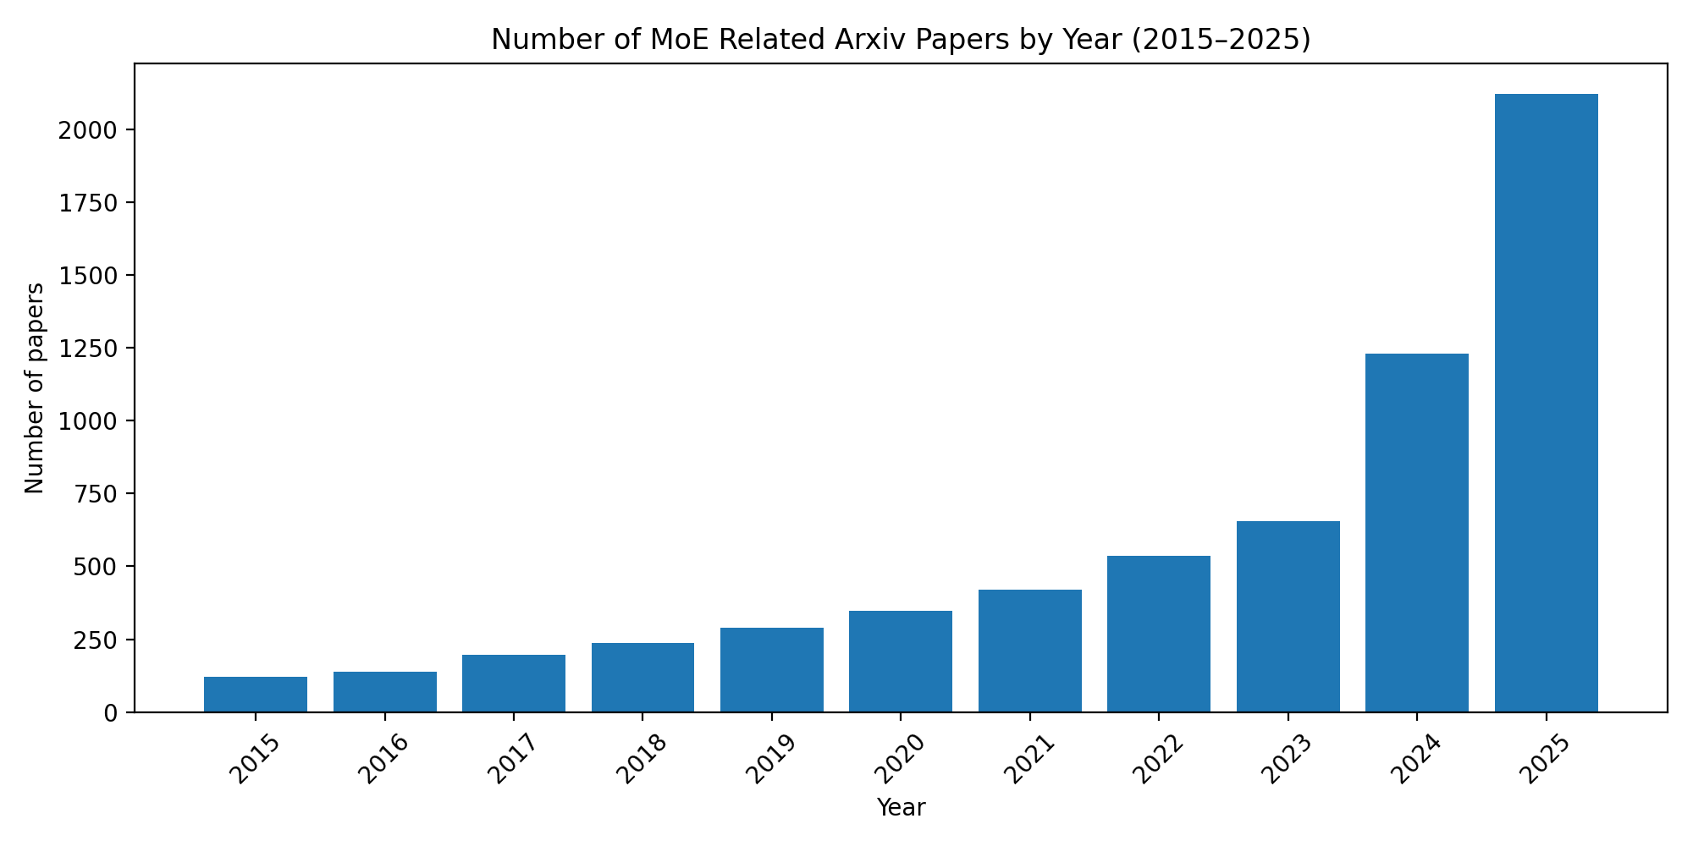
MoE Now
Switch Transformer: another sparsity trick

Slide 6
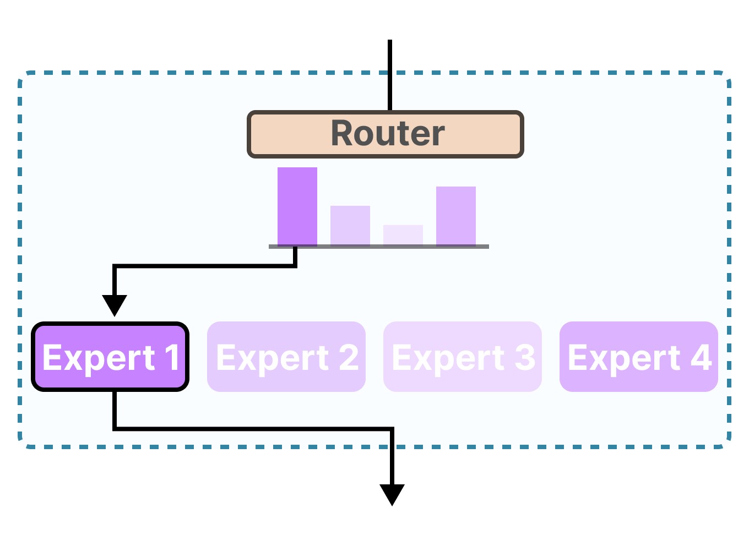
Ensemble LLM
These previous papers put the “experts” all inside of one network
Another similar line of work uses a single LLM as an “expert”, an LLM ensemble
Ensemble LLM works focus on routing (gating)-based methods

Slide 7
Our Method: Mixture of Thoughts (MoT)
Previous expert systems combine what the experts “say” at the end: at the output level
Motivation: Learn what each expert in the ensemble thinks and says for a more robust system

Slide 8
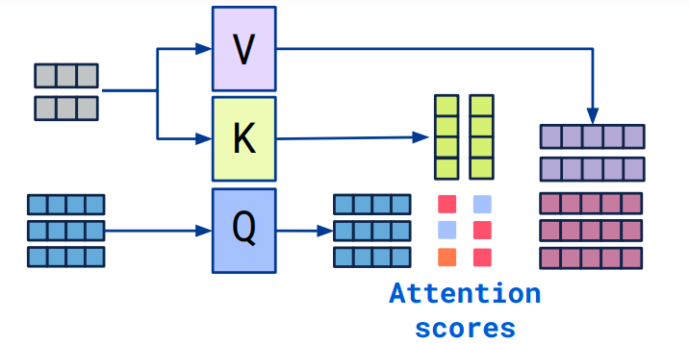
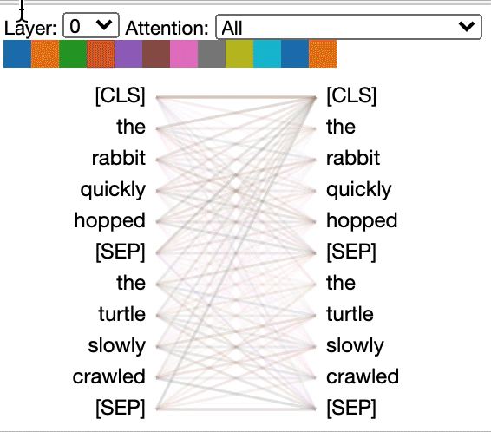
Attention and Cross Attention
Self-attention is the foundation of the Transformer
Self-attention compares a token to every other token in the same sequence
Cross-attention is slightly different, Q comes from one sequence and the KV values come from a different one.
Strong way of letting one source of information learn or “look” at another

Slide 9
Our Method cont.
An “Interaction Layer”
What the “stack” looks like

Slide 10
Results

Slide 11
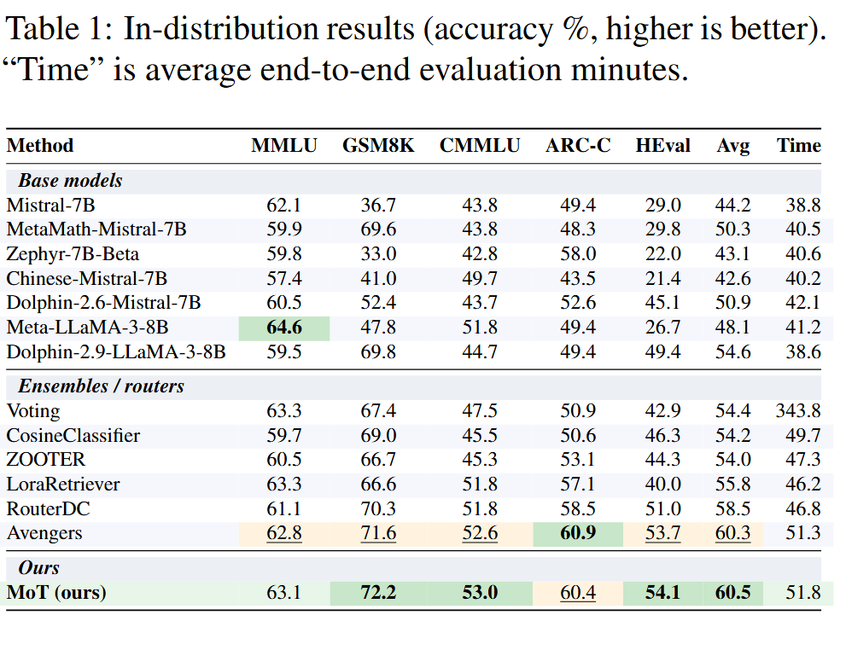
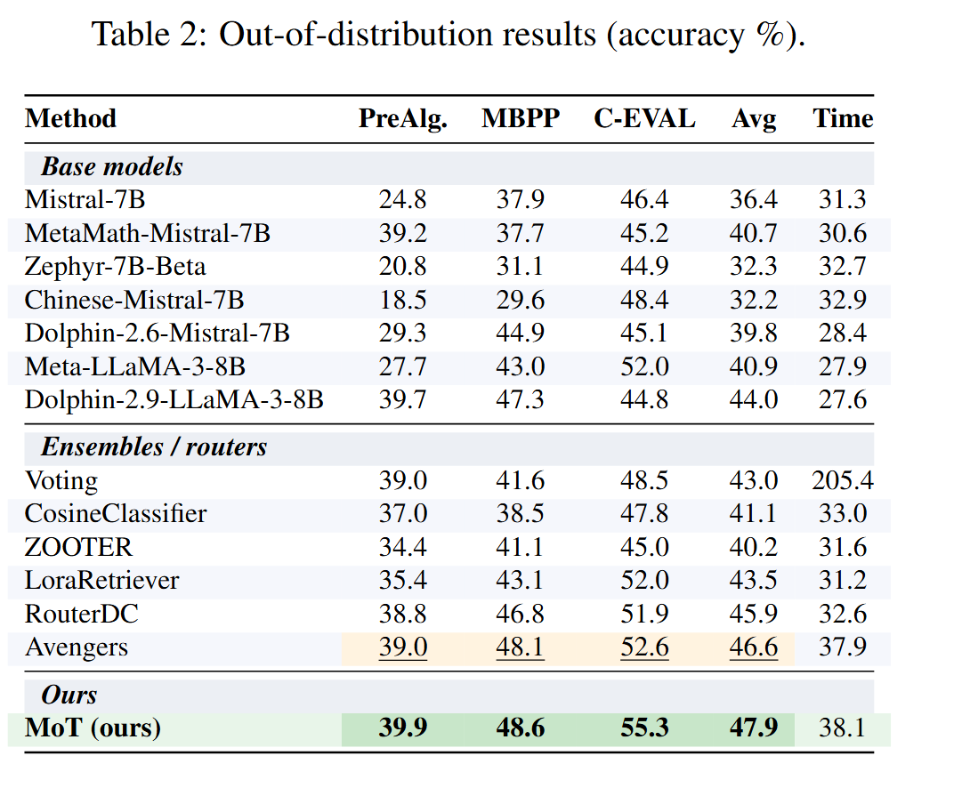
Results cont.

Slide 12
Bridging Hidden States in Vision-Language Models
Benjamin Fein-Ashley, Jacob Fein-Ashley

Slide 13
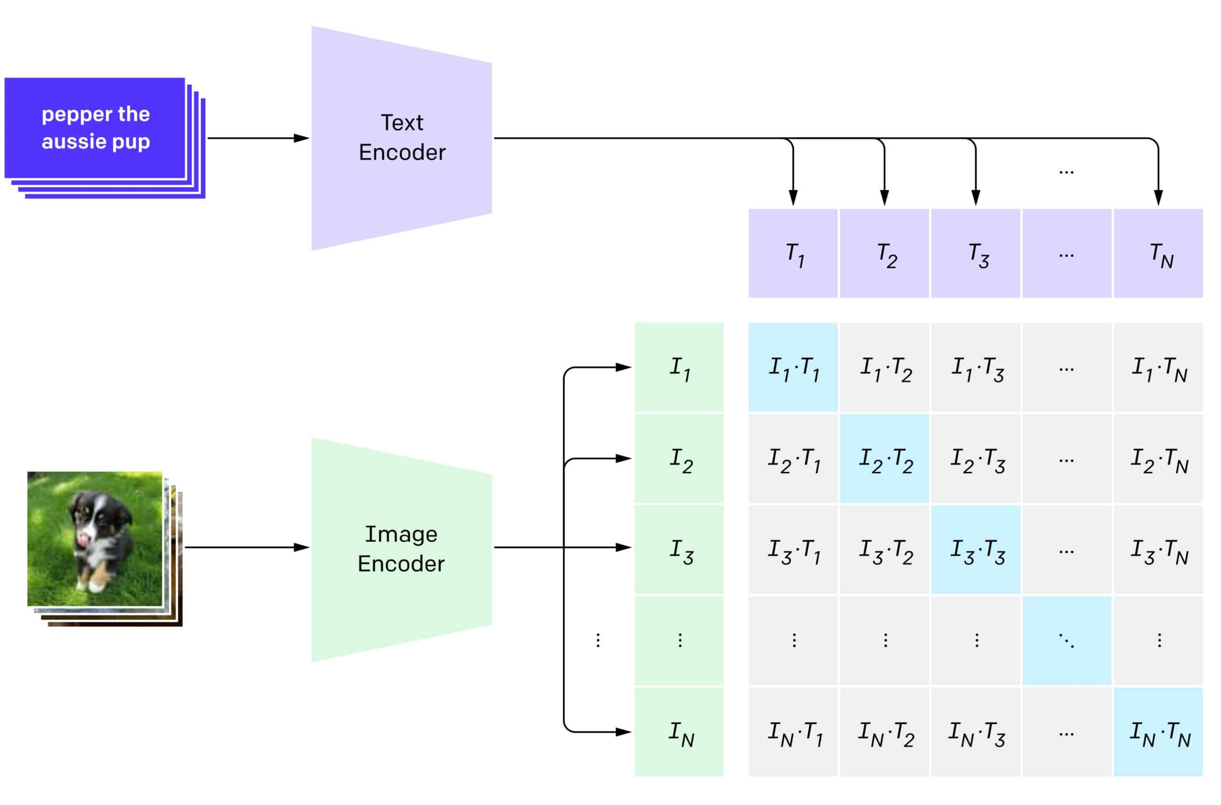
Vision Language Models (VLMs)

Slide 14
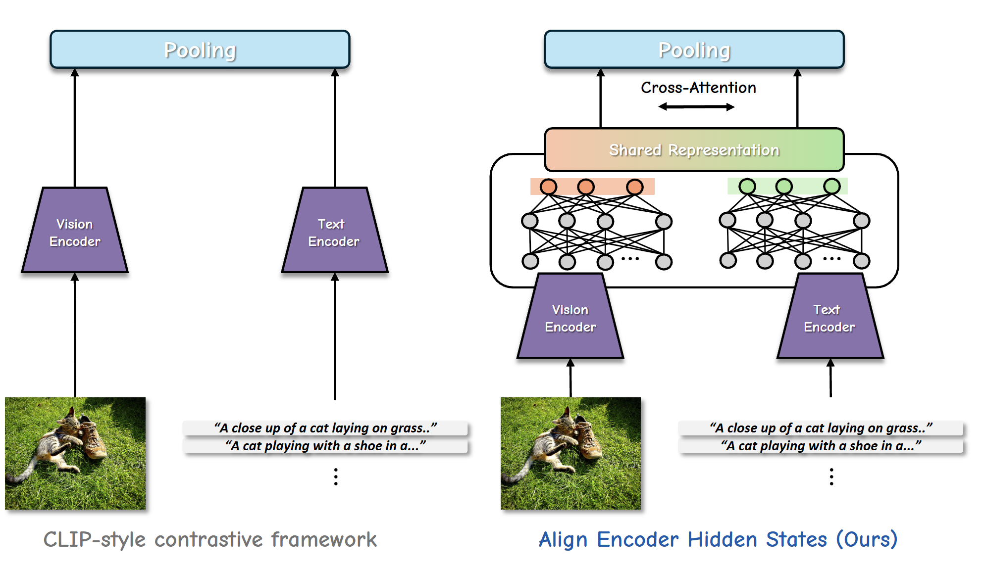
Similar Idea as Before Applied to VLMs

Slide 15
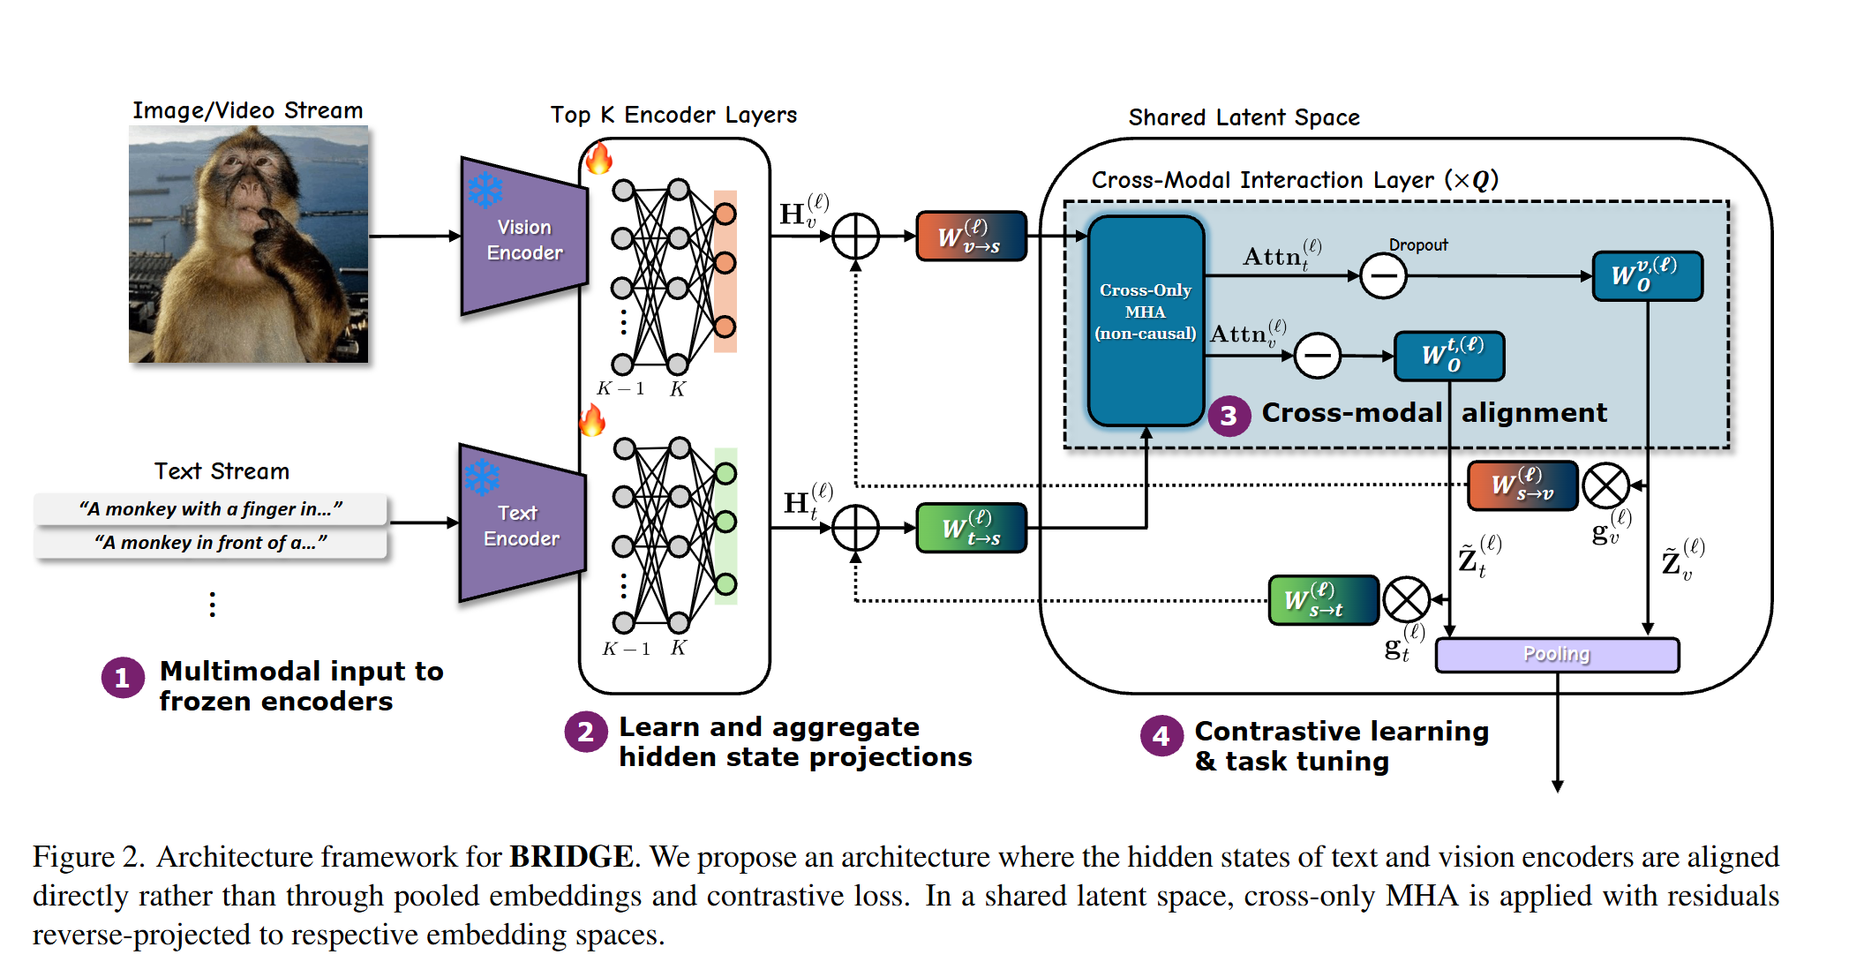
Architecture

Slide 16
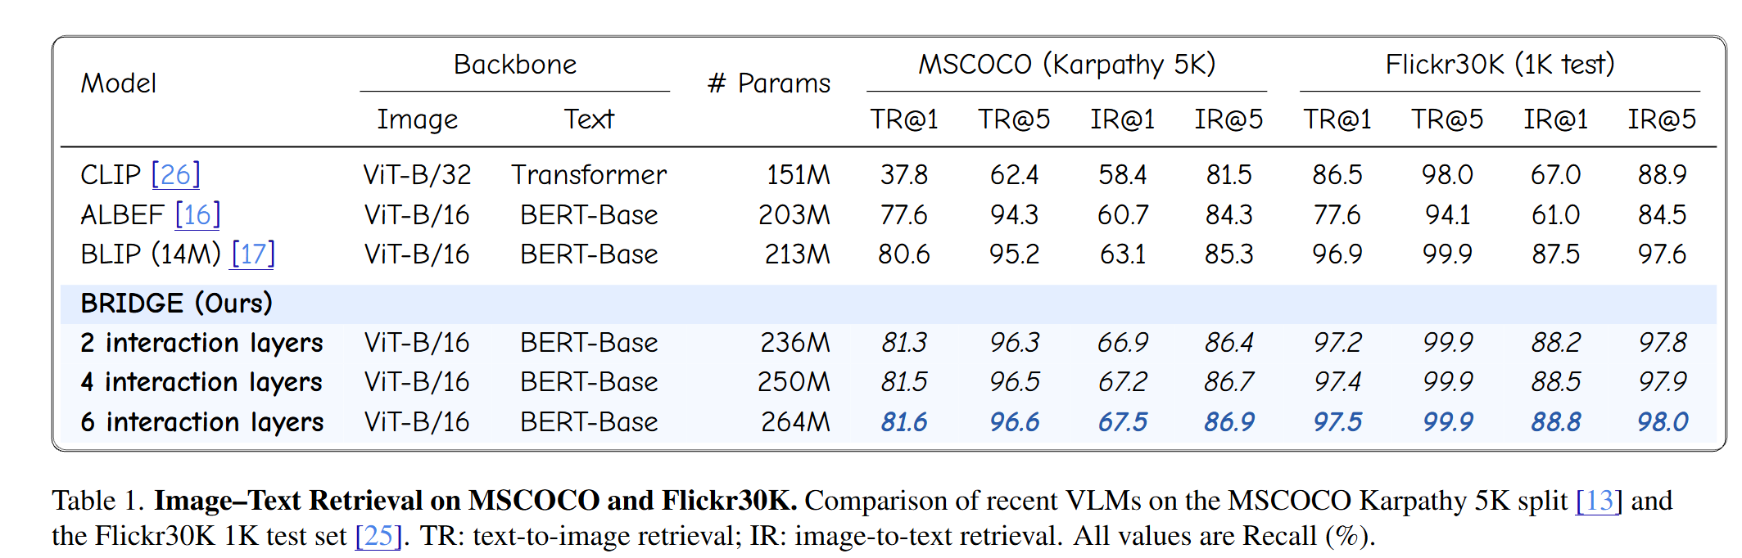
Results

Slide 17
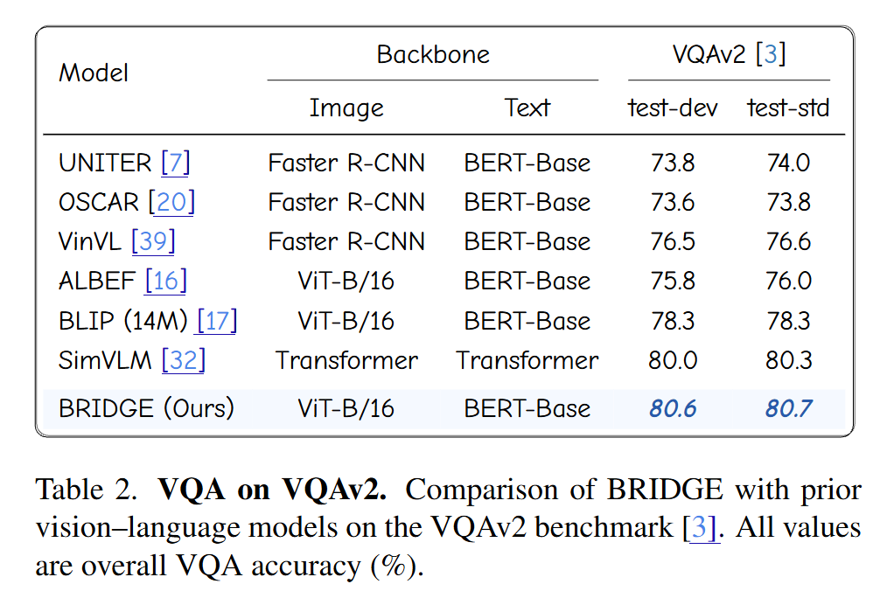
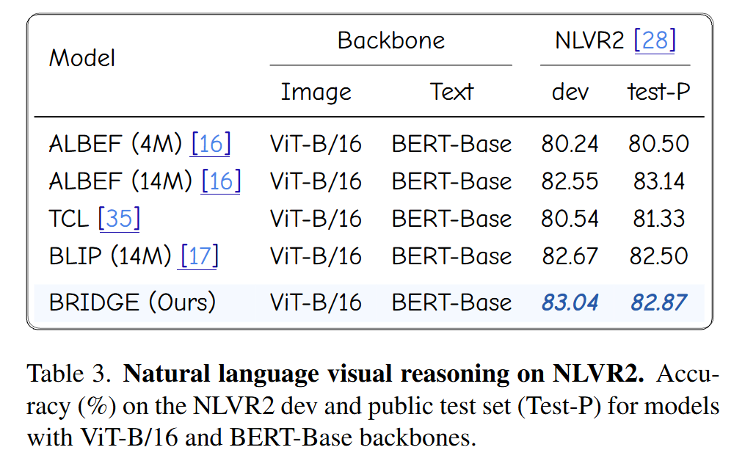
Results cont.

