Slide 1

Grokked Transformers are Implicit Reasoners:
A Mechanistic Journey to the Edge of Generalization
Boshi Wang Xiang Yue Yu Su Huan Sun

Slide 2
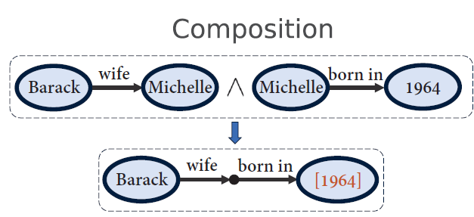
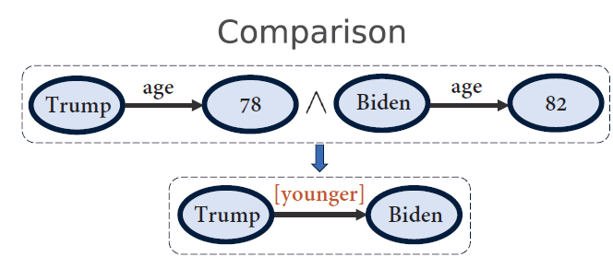
LLMs struggle at Implicit Reasoning w/ Parametric Memory
Implicit reasoning: reasoning without explicit verbalization of intermediate steps (e.g., Chain-of-Thought)
Parametric memory: facts & rules stored in weights
Press et al. & Yang et al.
LLMs only show substantial evidence in resolving the first hop
Scaling only improves the first hop; “compositionality gap” does not decrease
Zhu et al.
GPT-4 cannot do implicit composition or comparison well
Press et al. Measuring and Narrowing the Compositionality Gap in Language Models. Findings of EMNLP-23.
Yang et al. Do Large Language Models Latently Perform Multi-Hop Reasoning? ACL-24.
Zhu et al. Physics of Language Models: Part 3.2, Knowledge Manipulation. ICML-24 Tutorial.

Slide 3
Why Implicit Reasoning?
(can’t we just “CoT” everything?)
The default mode of large-scale (pre-)training
Fundamentally determines how well LLMs acquire structured representations of facts and rules from data
Propagateble knowledge updates & systematic generalization (more later)

Slide 4
Why Parametric Memory?
(can’t we do retrieval & long-context?)
Unique power in compressing and integrating information at scale
Important for tasks with large intrinsic complexity
  E.g., reasoning problems with large search spaces (example later)

Slide 5
Research Questions
Is implicit reasoning doomed given that even the most capable models struggle?
Can it be resolved by further scaling data and compute, or are there fundamental limitations of Transformers that prohibit robust acquisition of this skill?

Slide 6
Approach: Synthetic Data & Training from Scratch
Allows us to control the data and perform clean evaluations
Important nowadays as pretraining/fine-tuning corpora keeps penetrating downstream evals

Slide 7
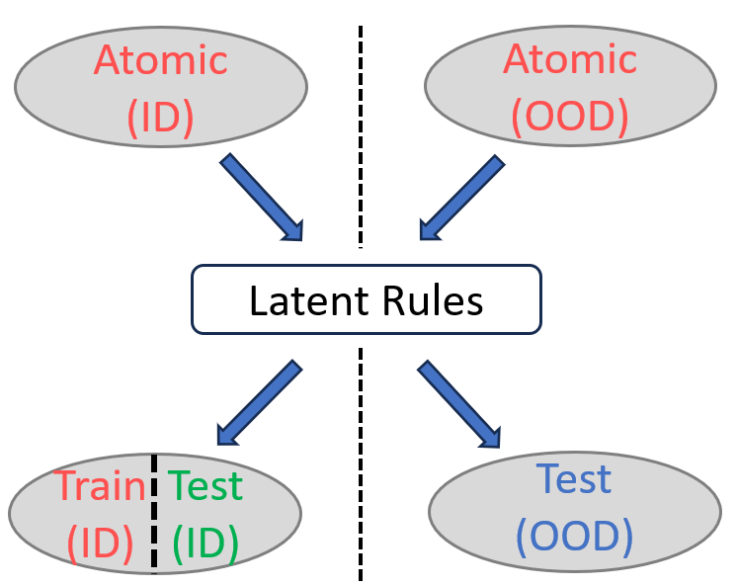
Reasoning as Rule Induction & Application
Induce latent rules from a mixture of atomic facts and inferred facts (deduced via latent rules)
Deduce novel facts by applying the acquired rules

Slide 8
Reasoning as Rule Induction & Application
ID: unseen inferred facts deduced from the same set of atomic facts underlying the observed inferred facts
OOD (systematicity): unseen inferred facts from a different set of atomic facts (Lake et al.)
Lake et al. Generalization without systematicity: On the compositional skills of sequence-to-sequence recurrent networks. ICML-18.

Slide 9
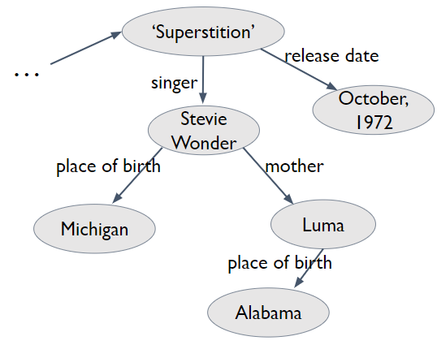
Reasoning as Rule Induction & Application
Composition
Atomic facts
  Random KG consisting of |R| = 200 relations
  Randomly split into ID & OOD atomic facts
Inferred facts: two-hop compositions

Slide 10
Model & Optimization
Standard decoder-only transformer as in GPT-2
  8 layers, 768 hidden dimensions and 12 attention heads
AdamW with learning rate 1e-4, batch size 512, weight decay 0.1 and 2000 warm-up steps
“Concept-level” inputs: each entity/relation has its own learnable embedding
More variants later

Slide 11
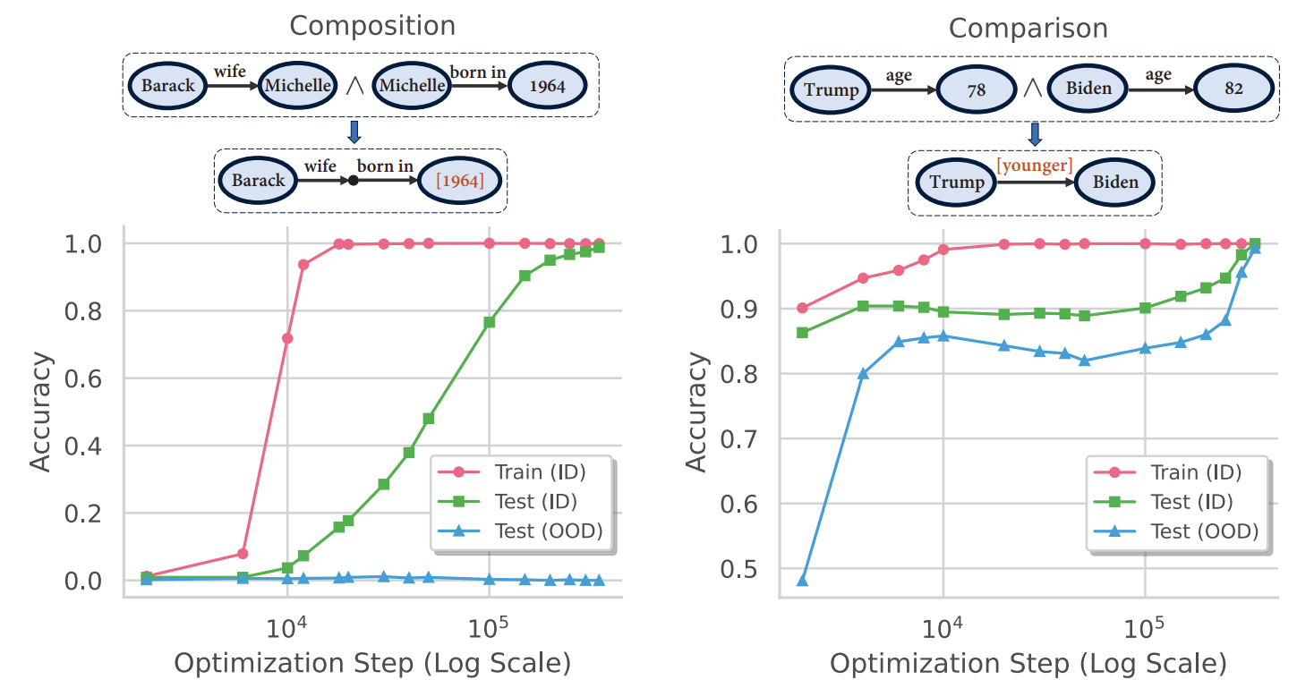
#1: “Grokking” in ID generalization

Slide 12
#2: Difference in OOD generalization

Slide 13
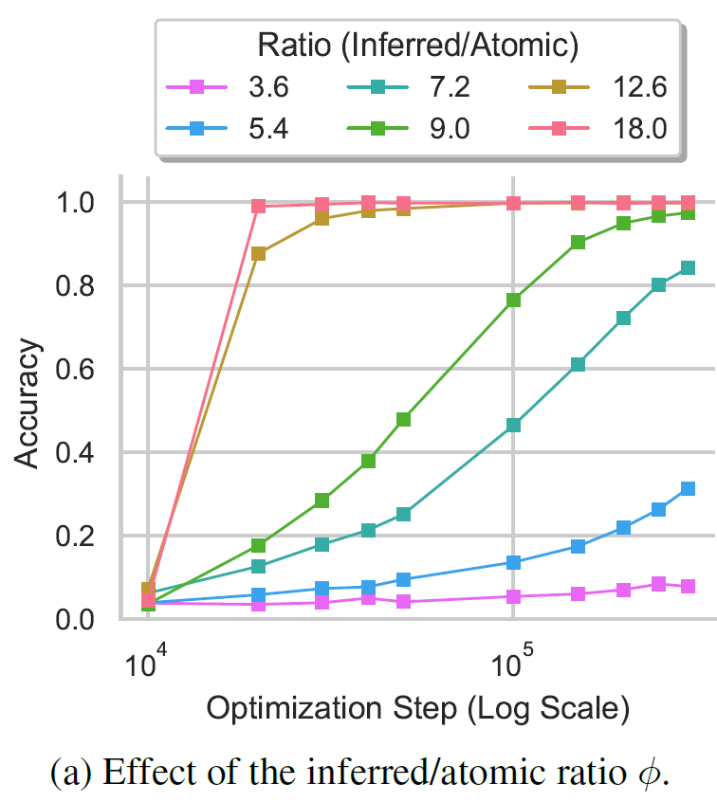
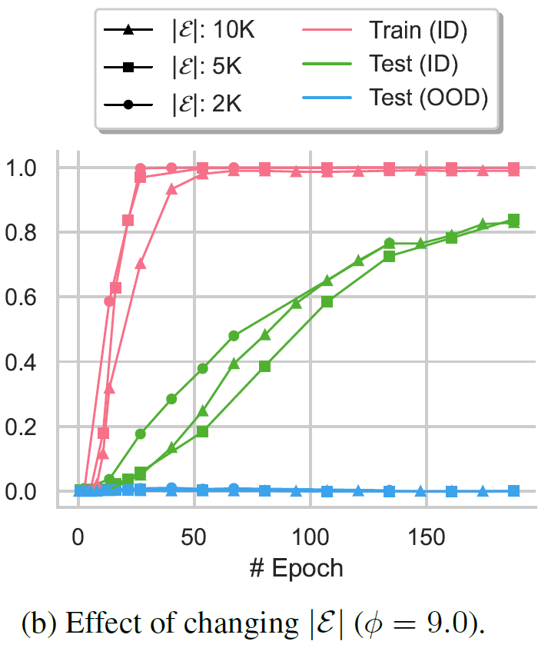
#3: Data distribution, not data size, drives generalization

Slide 14
Important Questions Remain
What happens during grokking?
Why does grokking happen?
Why no systematic generalization?
These require a deeper look inside of the model

Slide 15
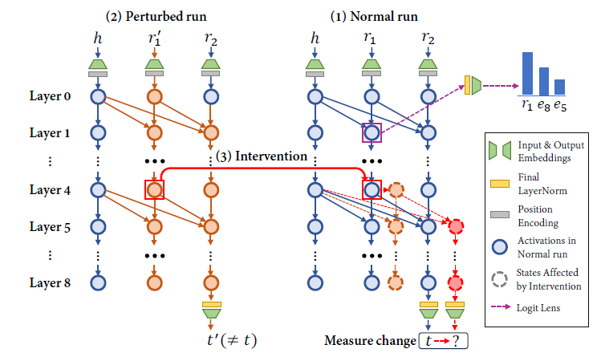
Analyzing the (change) in inner workings during grokking
Logit lens
Causal tracing

Slide 16
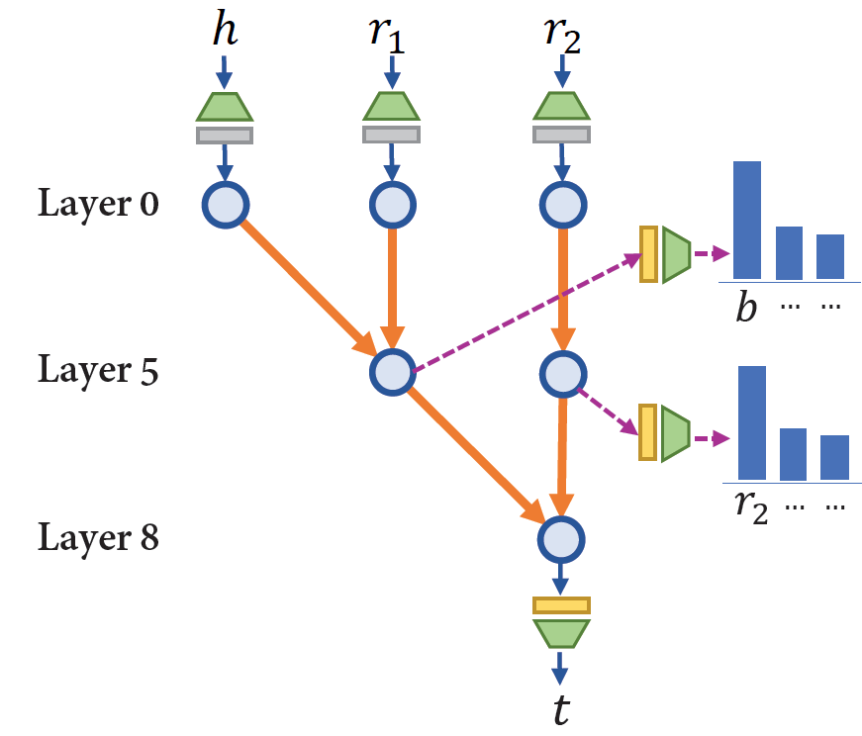
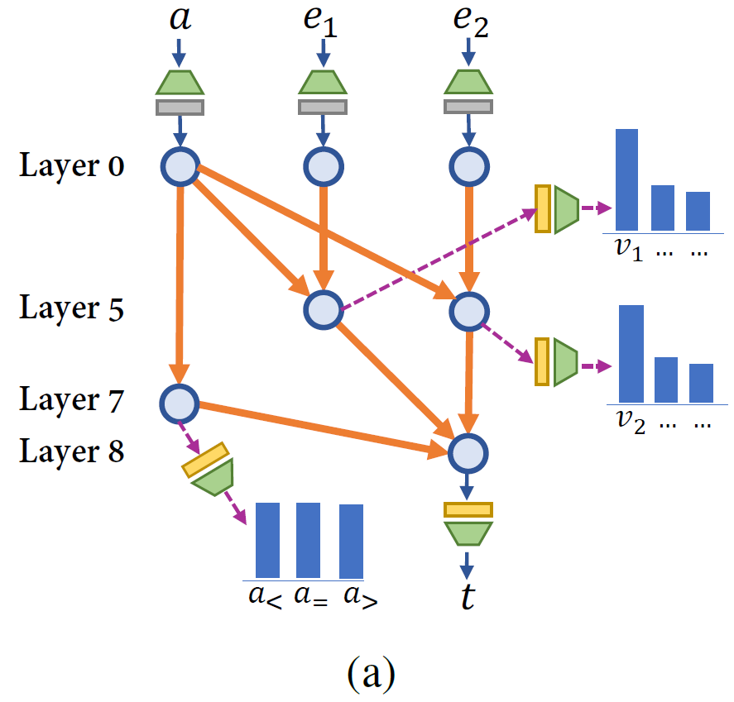
Generalizing Circuits (after Grokking)

Slide 17
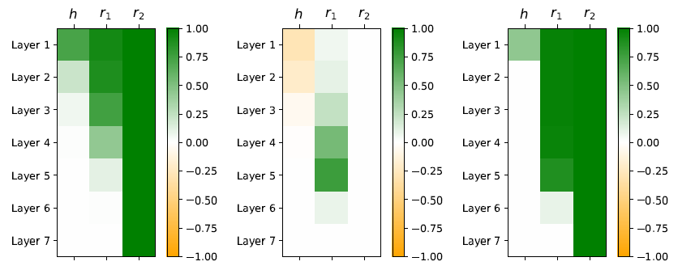
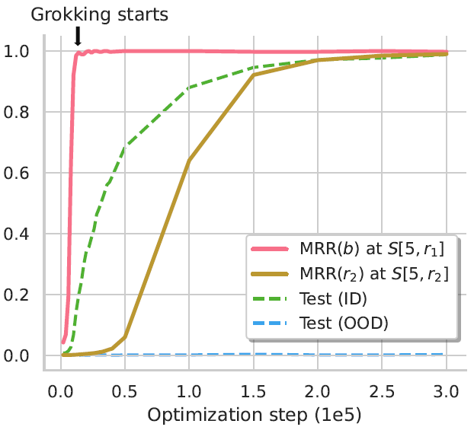
Changes during grokking
Causal strength
+
=
Start of grokking
Change during grokking
End of grokking
Causal connection between S[5, r1] and the final prediction t grows significantly
MRR(r2) gradually improves as S[5, r2] (via logit lens); S[5, r1] represents b throughout
=> Model gradually forms the second hop in the upper layers
When grokking starts, very likely directly associates (h, r1, r2) with t, mostly memorization

Slide 18
Understanding & Improving OOD generalization

Slide 19
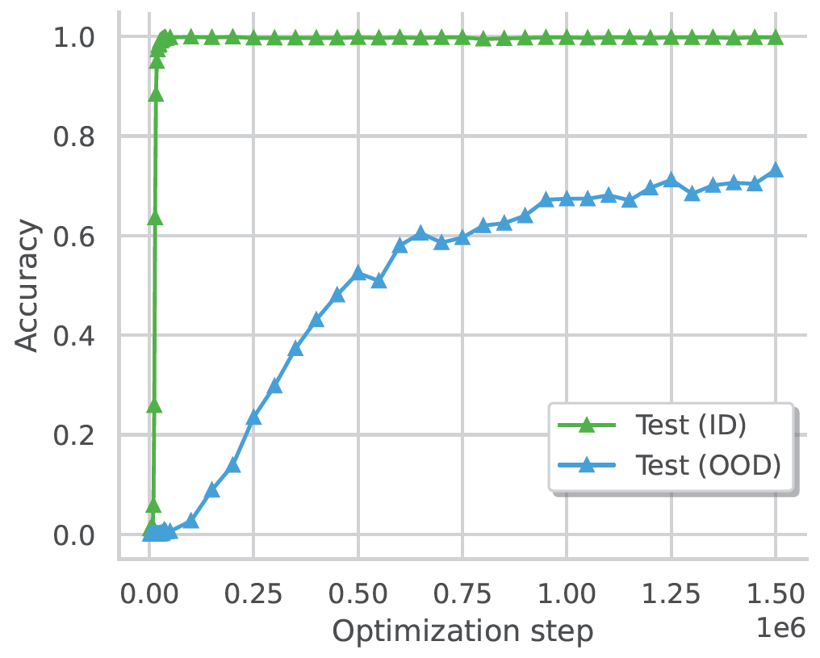
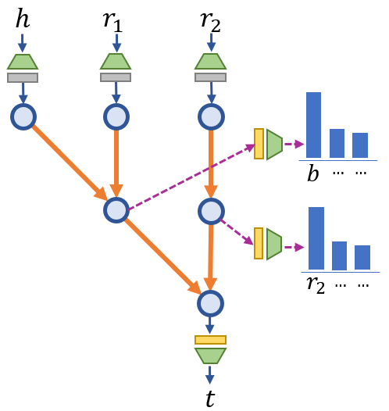
Understanding & Improving OOD generalization

Slide 20
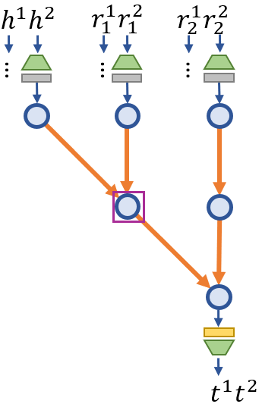
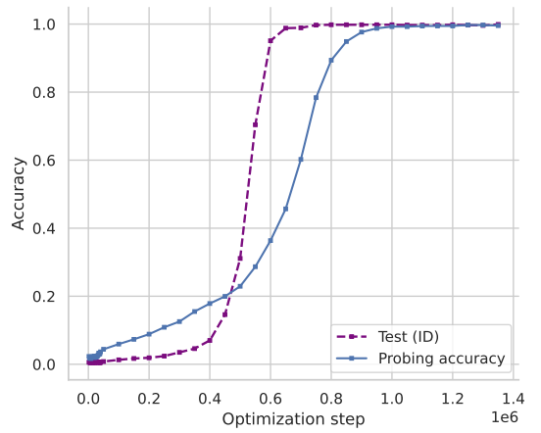
When inputs are at the surface level…
During grokking, the model seems to gradually stores the later surface-name tokens in the bridge hidden state

Slide 21
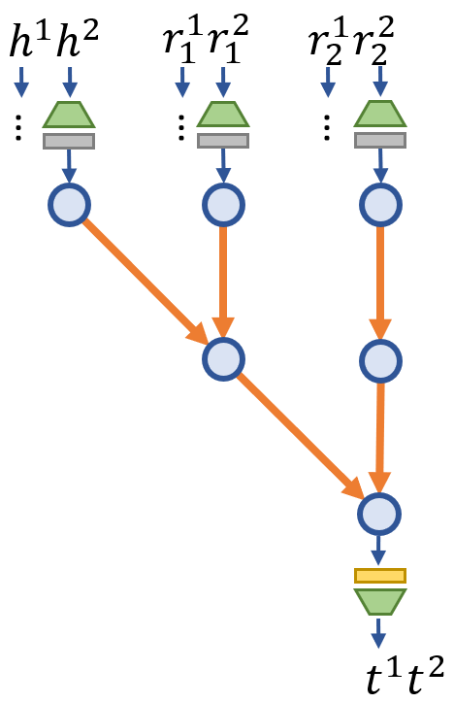
When inputs are at the surface level…
?

Slide 22
When inputs are at the surface level…
No OOD Generalization!

Slide 23
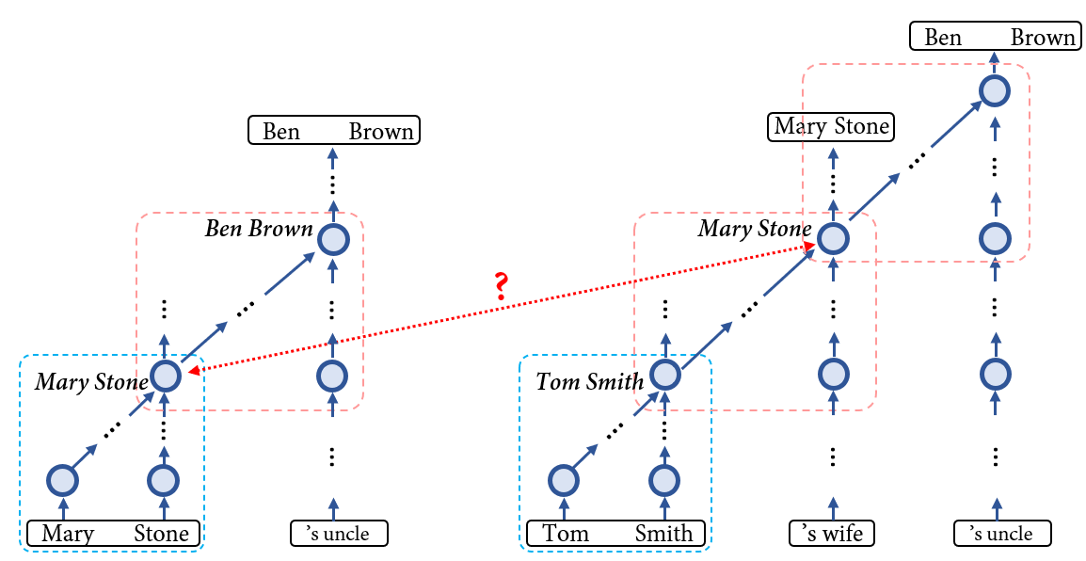
Surface-level Inputs & Binding

Slide 24
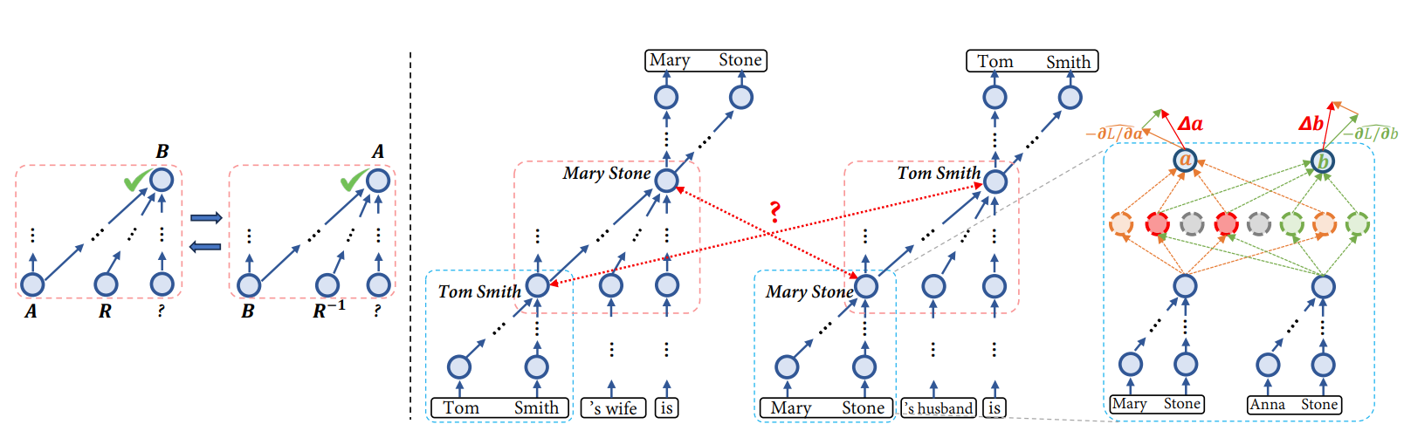
The binding problem & the “Reversal Curse”
Inconsistent entity representations when switching roles between perceived subjects and predicted objects
Representational entanglements cause interferences on learning dynamics and impede generalization
Wang et al. Is the Reversal Curse a Binding Problem? Uncovering Limitations of Transformers from a Basic Generalization Failure. arXiv-25.

Slide 25
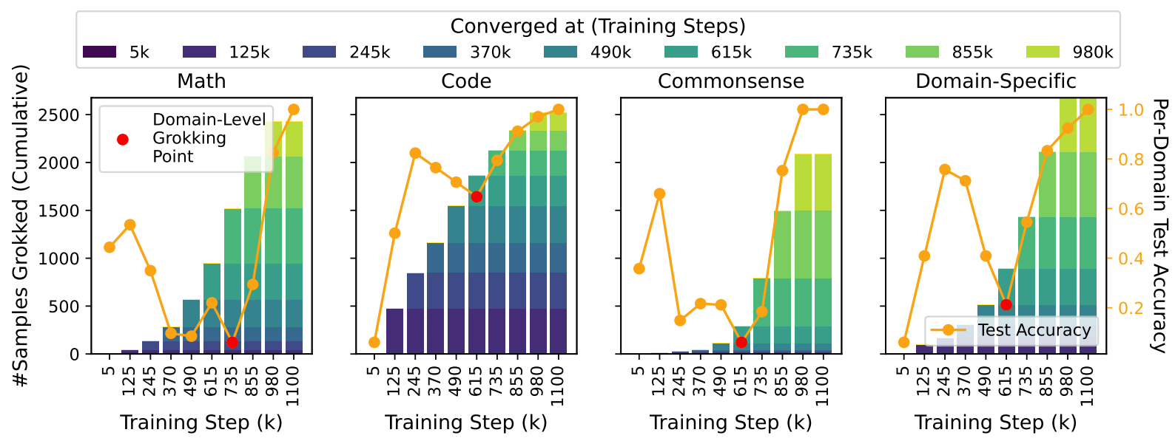
Grokking in LLM Pretraining
Li et al. Where to find Grokking in LLM Pretraining? Monitor Memorization-to-Generalization without Test. arXiv-25.

Slide 26
The Power of Parametric Memory for Complex Reasoning
What exactly are we going towards? Why parametric memory?
Unique ability to compress and integrate information at scale for complex reasoning

Slide 27
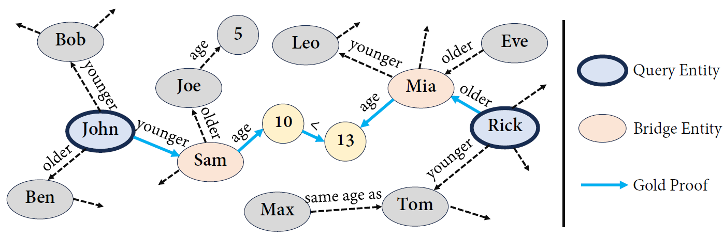
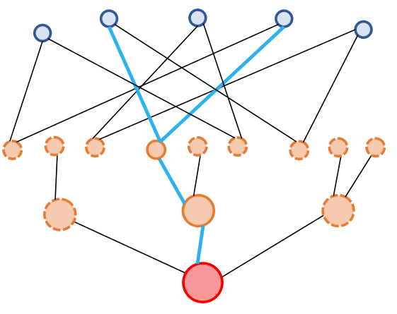
Challenging reasoning tasks with large search space
Non-parametric memory: information stored in context
  Explicit (verbalized) reasoning done in context
Parametric memory: information stored in weights
  Implicit reasoning done during information internalization

Slide 28
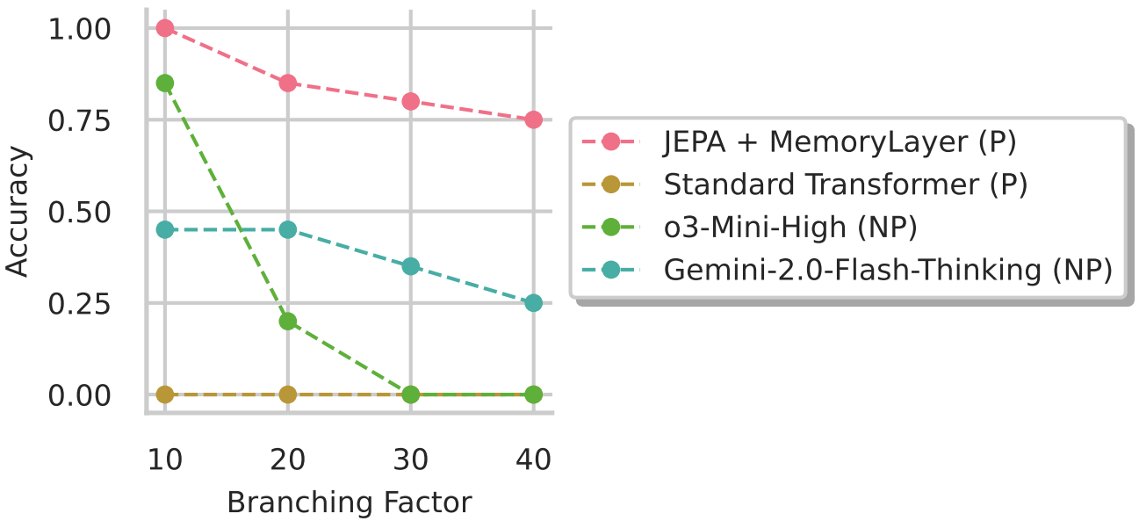
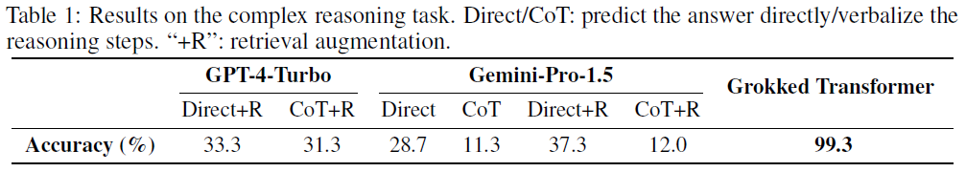
Challenging reasoning tasks with large search space

Slide 29
Summary & Discussion
Grokking in the acquisition of implicit reasoning skills
Various levels of generalization across tasks & rules
The binding problem in Transformer models
  Both individual concepts & atomic knowledge pieces
  Need systematic mechanisms with less human scaffolding
Explicit & implicit reasoning
  Chain-of-thought & “looped” Transformers
Non-parametric & Parametric Memory
  Long-context & “test-time training”

Slide 30
Thanks!
https://arxiv.org/abs/2405.15071
https://github.com/OSU-NLP-Group/GrokkedTransformer

