Slide 1




Decomposing QK Space
with Contrastive Covariances
Andrew Lee
Harvard
Yonatan Belinkov
Technion - IIT,
Kempner Institute
Fernanda Viégas
Harvard,
DeepMind
Martin Wattenberg
Harvard,
DeepMind

Slide 2
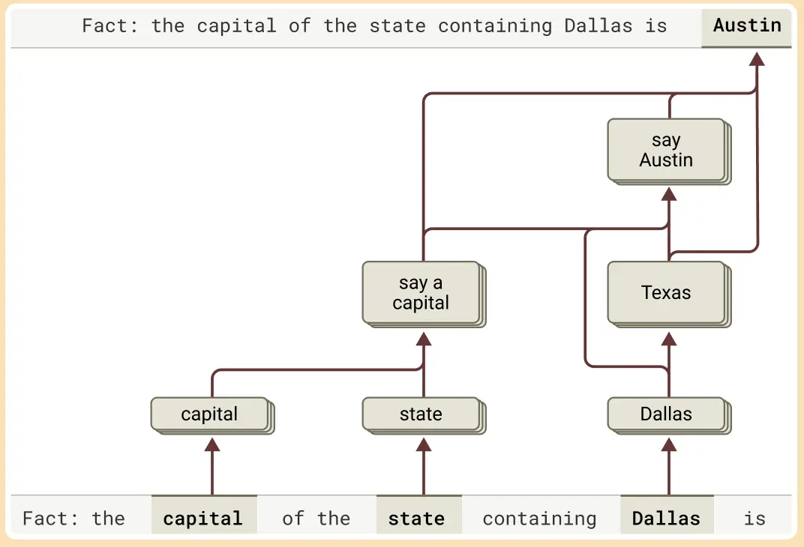
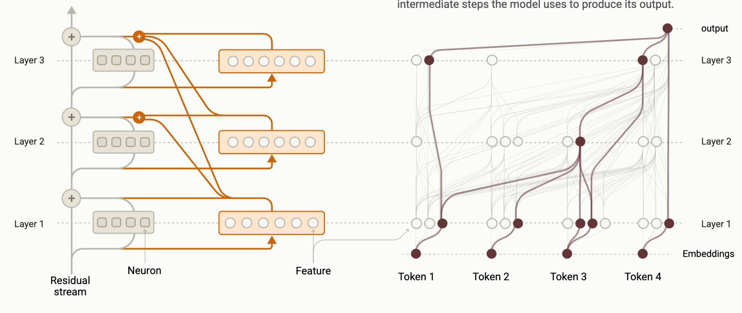
Recent progress on interpretability
Recent paradigm: Decompose model into sparse, interpretable components
  E.g., activations, MLP blocks
Allows researchers to construct “circuits”
Images from: Tracing the thoughts of a large language model: Anthropic

Slide 3
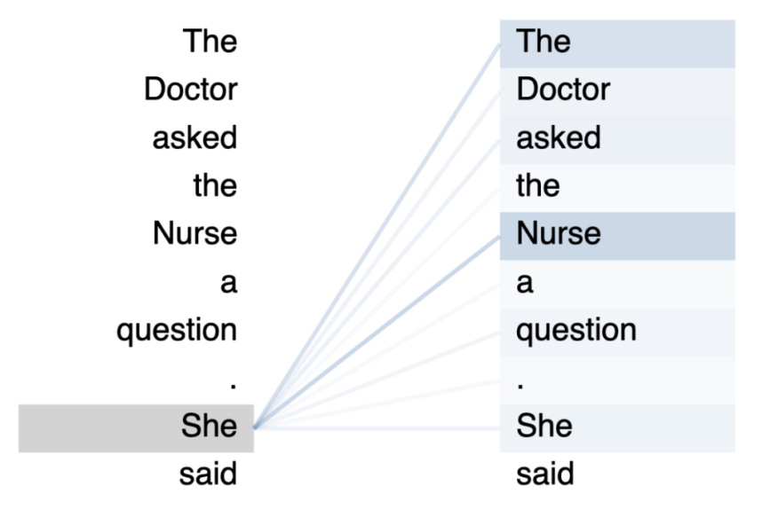
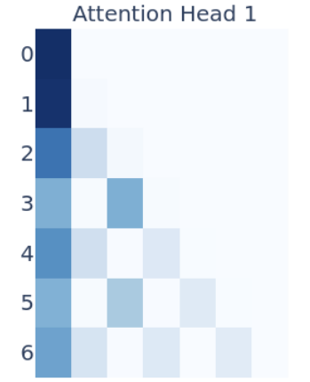
Recent progress on interpretability
But we do not know how to interpret attention!
  In circuit analyses, attention patterns are fixed
Why did an attention head attend to token X?

Slide 4








Quick recap: Attention
Attention
Scores
0.01
0.86
0.11
0.0
0.0
Softmax
Attention Logits
4.3
8.4
6.3
2.1
1.8
The
cat
sat
on
the

Slide 5


Quick recap: Attention
Attention
Scores
0.01
0.86
0.11
0.0
0.0
0.01
0.86
0.11
0.0
0.0
The
cat
sat
on
the

Slide 6
Quick recap: Attention
Why did an attention head attend to token X?
Why did an attention head attend to token X?
Why did the model produce this dot product?
Attention Logits
4.3
8.4
6.3
2.1
1.8
The
cat
sat
on
the

Slide 7

Quick recap: Attention
4.3
The
cat
sat
on
the

Slide 8

Query-Key (QK) Space
∈
QK Space:
Joint bi-linear embedding space:
Space of all possible query-key interactions!
The
cat
sat
on
the

Slide 9
Query-Key (QK) Space
∈
Goal: Decompose QK space into interpretable low-rank subspaces
The
cat
sat
on
the

Slide 10
Agenda
Toy Task / Model
Method: Contrastive Covariance
Results on Large Language Models

Slide 11




Toy Task Overview: Payload Retrieval
Assume a set of “payload embeddings” {x^{(i)}}...
and a “query embedding” x_{q} that specifies an embedding (x^{(i*)}) to fetch payload information from
We will train a single attention head to use x_{q} to attend to the correct embedding (x^{(i*)}) and decode the correct payload information
  No position embeddings, MLPs, residual connections…
  Just weights W_{Q}, W_{K}, W_{V}, W_{O}

Slide 12








Toy Task: Payload Retrieval
Each payload embedding x^{(i)} consists of 3 components:
  Two latent variables, z₁, z₂
  Payload (class) y ∈ {1, …, |Y|}
Each latent variable z₁, z₂ are random sign vectors of length r₁, r₂
Each are mapped to embedding space via maps A₁, A₂
  A₁, A₂ are fixed random Gaussians
Payload y is randomly sampled from {1, …, |Y|}
y is also embedded via map A_{y}
1
1
-1
1
-1
-1
1
-1
0
0
0
0
0
0
1
0
0
0

Slide 13





Toy Task: Payload Retrieval
Given a set of payload embeddings x_{1:T}…
Randomly select one as “target payload” (x^{(i*)})
Re-use latent variables z₁, z₂ from x^{(i*)} to create “query embedding” x_{q}
z₁^{(i*)}, z₂^{(i*)} mapped via different fixed linear maps B₁, B₂
Importantly, x_{q} does not contain any payload information
1
1
-1
1
-1
-1
1
-1

Slide 14

Toy Task: Payload Retrieval

Slide 15

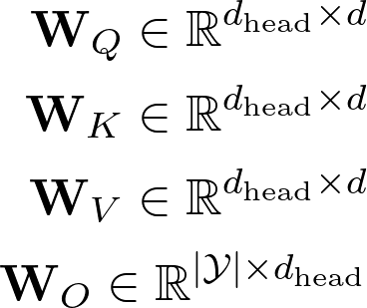
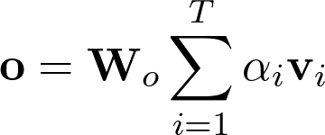
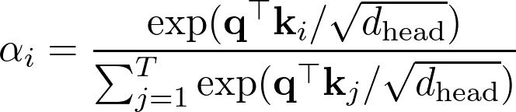



Toy Model
We will train a single attention head

Slide 16
Toy Model (Ideal Solution)
Ideally, the model learns W_{Q}, W_{K} such that q, k are aligned when both z₁, z₂ match
Use W_{V}, W_{O} to decode payload information (y)
As it turns out, the model easily learns this solution and reaches 100% accuracy

Slide 17
Agenda
Toy Task / Model
Method: Contrastive Covariance
Results on Large Language Models
Can we recover the subspace in QK-space in which latent variables z₁, z₂ are embedded?

Slide 18



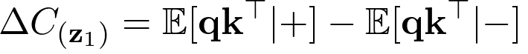

Contrastive Covariance Method
Per latent variable (i.e., z₁), define “positive” and “negative” covariance
Take their difference (a.k.a. Contrastive covariance)
SVD
Repeat for z₂

Slide 19
Contrastive Covariance Method
r₁ (Rank of z₁): number of singular values that account for 99% of |ΔC_{(z1)}|_{F}
U_{(z1)}[:r₁]: basis in query space that encodes z₁
V_{(z1)}[:r₁]: basis in key space that encodes z₁
Repeat procedure for z₂

Slide 20
Contrastive Covariance Method
r₁ (Rank of z₁): number of singular values that account for 99% of |ΔC_{(z1)}|_{F}
U_{(z1)}[:r₁]: basis in query space that encodes z₁
V_{(z1)}[:r₁]: basis in key space that encodes z₁
Repeat procedure for z₂

Slide 21
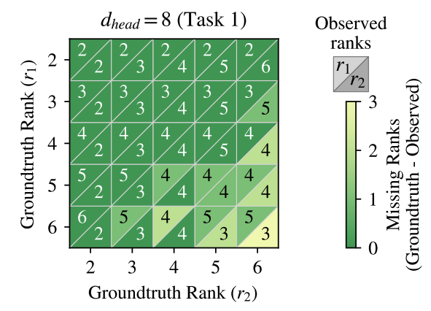
Toy Model Results
Can we recover the correct ranks of latent features?
Train attention head on varying task settings (vary r₁, r₂)

Slide 22
Toy Model Results
r₁ (Rank of z₁): number of singular values that account for 99% of |ΔC_{(z1)}|_{F}
U_{(z1)}[:r₁]: basis in query space that encodes z₁
V_{(z1)}[:r₁]: basis in key space that encodes z₁
Repeat procedure for z₂

Slide 23
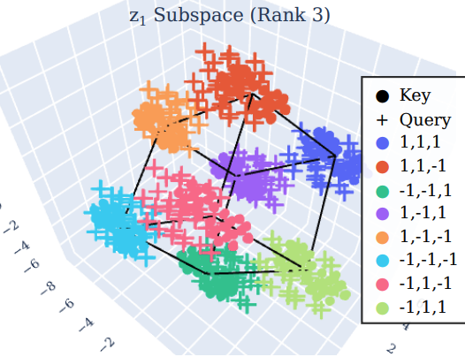
Toy Model Results
Consider model trained on r₁ = 3
  z₁ = {±1, ±1, ±1} – vertices of a cube
Given query vectors (q = W_{Q}x_{q} ∈ ℝ^{d_head}), key vectors (k = W_{K}x_{k}∈ ℝ^{d_head})
Project them onto U_{(z1)} ∈ ℝ³, V_{(z1)}∈ ℝ³
PCA!

Slide 24





Toy Model Results: Causal Interventions
encodes z₁ (query space)
encodes z₁ (key space)

Slide 25
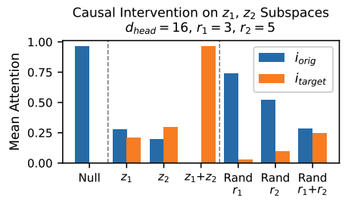
Toy Model Results: Causal Interventions

Slide 26
Agenda
Toy Task / Model
Method: Contrastive Covariance
Results on Large Language Models

Slide 27
LLM Results
“Filter Heads”
Binding Features
We study Llama 3.1-8B-Instruct and Qwen 3-4B-Instruct

Slide 28
Filter Heads
Cat, apple, dog, truck, orange, tea, car, duck. Find the fruits.
Attention heads that mirror “filter” functions [1]
What features are these heads using?
[1] Sharma, A. S., Rogers, G., Shapira, N., and Bau, D. Llms process lists with general filter heads. 2025

Slide 29



Filter Heads
Cat, apple, dog, truck, orange, tea, car, duck. Find the fruits.

Slide 30



Filter Heads
Cat, apple, dog, truck, orange, tea, car, duck. Find the animals.

Slide 31



Filter Heads
Cat, apple, dog, truck, orange, tea, car, duck. Find the vehicles.

Slide 32
Filter Heads
Compute △C for 5 categories
  Animals, countries, fruits, liquid, vehicles
Interestingly, every △C is rank 1
△C_{Category} = UΣV^{T}
Categorical semantic space in query space:
  U_{Categories} := span(U_{Animals}, U_{Countries}, U_{Fruits}, U_{Liquid}, U_{Vehicles})
Categorical semantic space in key space:
  V_{Categories} := span(V_{Animals}, V_{Countries}, V_{Fruits}, V_{Liquid}, V_{Vehicles})

Slide 33
Filter Heads (PCA)
Cat, apple, dog, truck, orange, tea, car, duck. Find the fruits.
Take key vectors for each entity
Take query vector (last token in input sentence)
Project query vectors onto U_{Categories} := span(U_{Animals}, U_{Countries}, U_{Fruits}, U_{Liquid}, U_{Vehicles})
Project key vectors onto V_{Categories} := span(V_{Animals}, V_{Countries}, V_{Fruits}, V_{Liquid}, V_{Vehicles})
PCA!

Slide 34
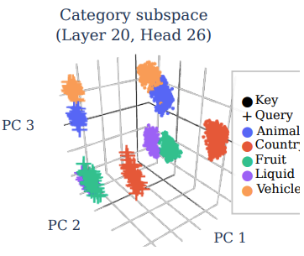
Filter Heads (PCA)
Cat, apple, dog, truck, orange, tea, car, duck. Find the fruits.

Slide 35
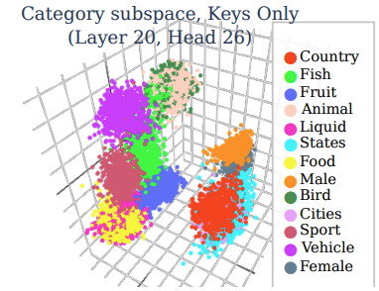
Filter Heads (PCA)
Expanding to 13 categories
(Visualizing keys only)

Slide 36
Filter Heads (Causal Interventions)
Cat, apple, dog, truck, orange, tea, car, duck. Find the fruits.
Given queried category c*, choose a different category c^{target}.
Project key vectors onto V_{Categories}, swap coordinates between c*, c^{target}

Slide 37
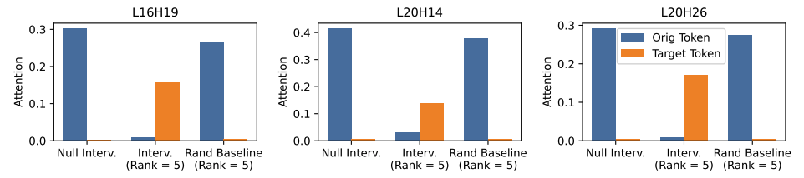
Filter Heads (Causal Interventions)
Cat, apple, dog, truck, orange, tea, car, duck. Find the fruits.
Given queried category c*, choose a different category c^{target}.
Project key vectors onto V_{Categories}, swap coordinates between c*, c^{target}

Slide 38
Binding Features
The hat is in box O. The jam is in box Z. The cat is in box B. The book is in box J. Which box is the jam in?
Multiple binding features (“tags”) that the model uses [1]
[1] Yoav Gur-Arieh, Mor Geva, Atticus Geiger. Mixing Mechanisms: How Language Models Retrieve Bound Entities In-Context. 2025

Slide 39
Binding Features
The hat is in box O. The jam is in box Z. The cat is in box B. The book is in box J. Which box is the jam in?
1
1
2
2
3
3
4
4
2
Multiple binding features (“tags”) that the model uses [1]
Order-IDs
  Model “tags” the order in which entity-box pairs appear
  Use “order-ID tag” to retrieve correct box
[1] Yoav Gur-Arieh, Mor Geva, Atticus Geiger. Mixing Mechanisms: How Language Models Retrieve Bound Entities In-Context. 2025

Slide 40
Binding Features
The hat is in box O. The jam is in box Z. The cat is in box B. The book is in box J. Which box is the jam in?
hat
jam
cat
book
Multiple binding features (“tags”) that the model uses [1]
Order-IDs
  Model “tags” the order in which entity-box pairs appear
  Use “order-ID tag” to retrieve correct box
Lexical-IDs
  The “intuitive” solution: retrieve box based on queried entity
[1] Yoav Gur-Arieh, Mor Geva, Atticus Geiger. Mixing Mechanisms: How Language Models Retrieve Bound Entities In-Context. 2025

Slide 41


Binding Features: Order-ID
The hat is in box O. The jam is in box Z. The cat is in box B. The book is in box J. Which box is the jam in?
1
1
2
2
3
3
4
4
2
Importantly: we use the same entity tokens and box tokens in all of our samples
This allows us to factor out lexical information

Slide 42


Binding Features: Lexical-ID
The hat is in box O. The jam is in box Z. The cat is in box B. The book is in box J. Which box is the jam in?
The hat is in box O. The cup is in box Z. The cat is in box B. The book is in box J. Which box is the cup in?

Slide 43
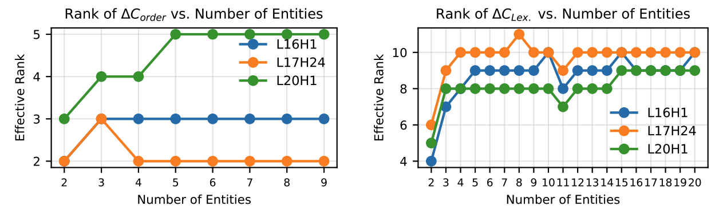
Low-Rank Binding Features
△C_{Order}, △C_{Lexical} are low-rank
i.e., binding features live in low-rank subspaces

Slide 44
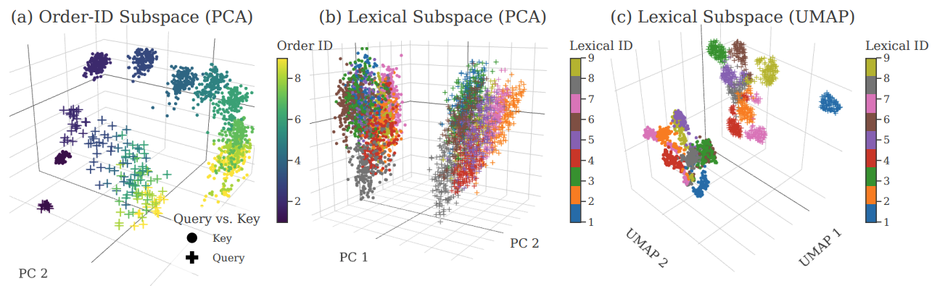
Binding Subspaces (PCA)
The hat is in box O. The jam is in box Z. The cat is in box B. The book is in box J. Which box is the jam in?
Project key, query vectors onto U_{Order}, V_{Order}

Slide 45
Binding Subspaces (PCA)
The hat is in box O. The jam is in box Z. The cat is in box B. The book is in box J. Which box is the jam in?
Project key, query vectors onto U_{Lex}, V_{Lex}

Slide 46
Binding Subspaces (Causal Interventions)
The hat is in box O. The jam is in box Z. The cat is in box B. The book is in box J. Which box is the jam in?
Given queried box b*, choose a different box b^{target}.
Project key vectors onto V_{Order}, V_{Lexical}, or both. Swap coordinates between b*, b^{target}

Slide 47
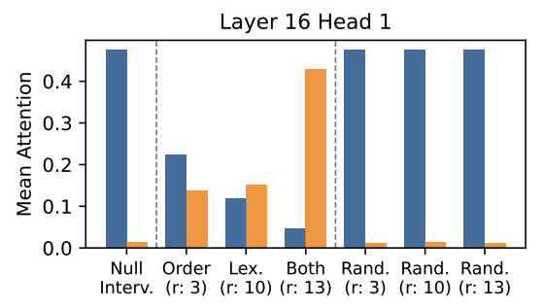
Binding Subspaces (Causal Interventions)

Slide 48
Takeaways
Decomposing QK space reveals low-rank subspaces encoding features
Future directions:
  Contrastive covariance relies on carefully crafted +/- pairs - how to remove this constraint?
  SAEs assume rank-1 decompositions - should we be designing low-rank decompositions?

Slide 49
Thank you!
Andrew Lee
Harvard
Yonatan Belinkov
Technion - IIT,
Kempner Institute
Fernanda Viégas
Harvard,
DeepMind
Martin Wattenberg
Harvard,
DeepMind

